Slide 1
Patterns and correlates of pregabalin use among a sample of people who inject drugs in Australia
R. Sutherland, P. Dietze, N. Gisev, R. Bruno, Campbell, G., Memedovic, S. & A. Peacock

Slide 2
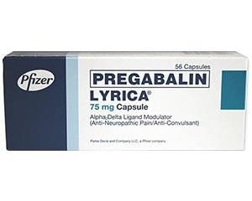
Background: Pregabalin in Australia
Gamma‐aminobutyric acid (GABA) analogue that has analgesic and anti-convulsant effects

Slide 3
Background: Pregabalin in Australia
Gamma‐aminobutyric acid (GABA) analogue that has analgesic and anti-convulsant effects
Registered in Australia in 2005 as a Schedule 4 (prescription only) medicine for treatment of neuropathic pain and epilepsy

Slide 4
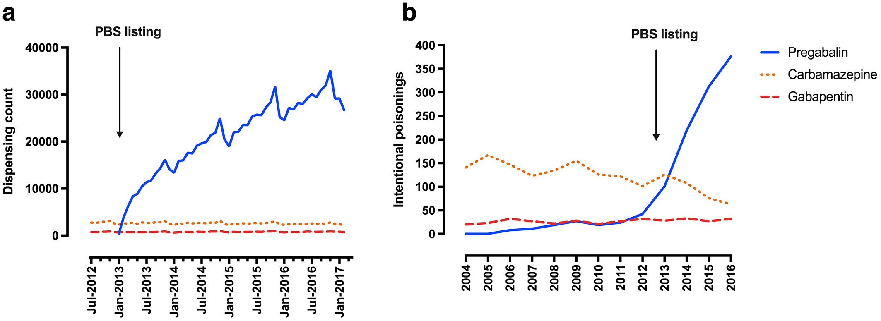
Background: Pregabalin in Australia
Gamma‐aminobutyric acid (GABA) analogue that has analgesic and anti-convulsant effects
Registered in Australia in 2005 as a Schedule 4 (prescription only) medicine for treatment of neuropathic pain and epilepsy
Monthly dispensing
Intentional poisonings reported to NSWPIC
Cairns R, Schaffer AL, Ryan N, et al. Rising pregabalin use and misuse in Australia: trends in utilization and intentional poisonings. Addiction 2018; https://doi.org/10.1111/add.14412.

Slide 5
Aims
Examine patterns of pregabalin use (prescribed and not prescribed) among a sample of people who frequently inject drugs (PWID) in Australia.

Slide 6
Aims
Examine patterns of pregabalin use (prescribed and not prescribed) among a sample of people who frequently inject drugs (PWID) in Australia.
Identify correlates of prescribed and non-prescribed pregabalin use among PWID.

Slide 7
AIM
To establish, maintain, and continuously improve monitoring of trends in illicit drug use, harms, and markets across Australia
DATA SOURCES
National Monitoring: Secondary Data
Jurisdictional Monitoring: Secondary Data
Sentinel Sample Monitoring
Online Monitoring
Mortality Data
Drug-induced deaths from registry and coronial data
Hospitalisation Data
Drug-induced hospitalisations
Other Sources
Household survey, treatment data etc
Various sources assessing drug use and harms at the population-level (e.g., emergency department presentations) and subpopulation level (e.g., needle-syringe program visits)
Illicit Drug Reporting System (IDRS)
Annual interviews with people who inject drugs (IDRS)
~900 per/year
Cryptomarket Data
Scraping listings on darknet drug markets
OUTPUT
Input from researchers, national stakeholders, and jurisdiction stakeholders to inform priority research questions
Analytical reports

Slide 8
Aim 1: Patterns of pregabalin use, 2018-2019

Slide 9
Past six month pregabalin use, 2018-2019
0.7% injected: 2018 and 2019

Slide 10
Frequency of use, 2018-2019
*p<0.05

Slide 11
Aim 2: Who is using pregabalin?

Slide 12

Correlates of pregabalin use, 2018
 | Prescribed use only (n=86) | Non-prescribed use only (n=133)
Non-prescribed pharmaceutical opioid use %
Prescribed benzodiazepine use %
Non-prescribed benzodiazepine use %
Stimulant use %
Overdose (past year) %
Pain/discomfort (day of interview) %
No pregabalin use (n=678) is the referent category. Those who had used both prescribed and non-prescribed pregabalin (n=7) excluded from analysis
Notes:
Non-prescribed consumers less likely to report pain/discomfort on day of interview compared to prescribed consumers

Slide 13
Implications
Elevated overdose risk associated with combined use of pregabalin and opioids
Notes:
Use is relatively common, with little overlap between prescribed and non-prescribed use, sufficient coverage for prescribed use
Findings of concern given the elevated overdose risk associated with combined use of opioids and pregabalin
Harm reduction messages re: concomitant use of these substances (consumers and prescribers)
Non-prescribed pregabalin consumers appear to be a riskier group of consumers (e.g. non-fatal overdose, stimulant use)
Pain/discomfort not associated with non-prescribed pregabalin use → may be using these substances for a range of reasons (e.g. intoxication, euphoric and dissociative effects)

Slide 14
Implications
Elevated overdose risk associated with combined use of pregabalin and opioids
Harm reduction messages re: concomitant use of opioids and pregabalin (consumers and prescribers), incorporated into existing overdose materials
Notes:
Use is relatively common, with little overlap between prescribed and non-prescribed use
Findings of concern given the elevated overdose risk associated with combined use of opioids and pregabalin
Harm reduction messages re: concomitant use of these substances (consumers and prescribers)
Non-prescribed pregabalin consumers appear to be a riskier group of consumers (e.g. non-fatal overdose, stimulant use)
Pain/discomfort not associated with non-prescribed pregabalin use → may be using these substances for a range of reasons (e.g. intoxication, euphoric and dissociative effects)

Slide 15
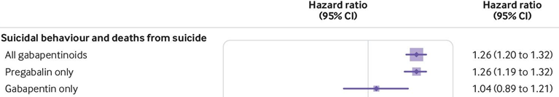
Implications
Elevated overdose risk associated with combined use of pregabalin and opioids
Harm reduction messages re: concomitant use of opioids and pregabalin (consumers and prescribers)
Molero et al BMJ 2019; 365: l2147
Notes:
Use is relatively common, with little overlap between prescribed and non-prescribed use
Findings of concern given the elevated overdose risk associated with combined use of opioids and pregabalin
Harm reduction messages re: concomitant use of these substances (consumers and prescribers)
Non-prescribed pregabalin consumers appear to be a riskier group of consumers (e.g. non-fatal overdose, stimulant use)
Pain/discomfort not associated with non-prescribed pregabalin use → may be using these substances for a range of reasons (e.g. intoxication, euphoric and dissociative effects)

Slide 16







Disclosures and acknowledgements
AP – untied educational grant from Seqirus and Mundipharma for study of opioid medications
RS – untied educational grant from Seqirus for study of opioid medications
SM – untied educational grant from Seqirus for study of opioid medications
RB – untied educational grant from Mundipharma and Indivior for study of opioid medications
PD – untied educational grant from Indivior/investigator grant from Gilead Sciences
GC – untied educational grant from Indivior for study of opioid medications
No pharmaceutical grants were received for this study.
These parties had no role in the study design, conduct and reporting.
rachels@unsw.edu.au

