Slide 1






Studying trends in fatal and non-fatal overdose: Findings from Drug Trends 2019
Australasian Professional Society on Alcohol and other Drugs Conference, Hobart, 2019
Amy Peacock, National Drug and Alcohol Research Centre, UNSW, Sydney

Slide 2
Acknowledgements
Funding:
Australian Government Department of Health
Drug Trends Team:
National Drug and Alcohol Research Centre: Nicola Man, Agata Chrzanowska, Antonia Karlsson, Julia Uporova, Daisy Gibbs, Rosie Swanton, Olivia Price, Louisa Degenhardt, Michael Farrell
Burnet Institute: Amy Kirwan, Cristal Hall, Campbell Aitken, Paul Dietze
School of Medicine, University of Tasmania: Callula Sharman and Raimondo Bruno
National Drug Research Institute: James Fetherston, Jodie Griggs, Seraina Agramunt, Simon Lenton
Institute for Social Science Research, The University of Queensland (QLD): Catherine Daly, Leith Morris, Caroline Salom
Northern Territory Department of Health: Chris Moon
Other Acknowledgements:
IDRS participants and data custodians (including the Australian Bureau of Statistics)
Conflicts of interest:
Amy Peacock: untied educational grant from Mundipharma and Seqirus for study of opioid medications
Raimondo Bruno: untied educational grant from Mundipharma and Indivior for study of opioid medications
Louisa Degenhardt: untied educational grant from Mundipharma, Seqirus and Indivior for study of opioid medications
Michael Farrell: untied educational grant from Mundipharma, Seqirus and Indivior for study of opioid medications
Paul Dietze: untied educational grant from Gilead Sciences for HCV research and untied educational grant from Indivior

Slide 3
AIM
To establish, maintain, and continuously improve monitoring of trends in illicit drug use, harms, and markets across Australia
DATA SOURCES
National Monitoring: Secondary Data
Jurisdictional Monitoring: Secondary Data
Sentinel Sample Monitoring
Online Monitoring
Mortality Data
Drug-induced deaths from registry and coronial data
Hospitalisation Data
Drug-induced hospitalisations
Other Sources
Household survey, treatment data etc
Various sources assessing drug use and harms at the population-level (e.g., emergency department presentations) and subpopulation level (e.g., needle-syringe program visits)
Illicit Drug Reporting System (IDRS)
Ecstasy and Related Drug Reporting System (EDRS)
Annual interviews with people who inject drugs (IDRS) and who use stimulants (EDRS)
Cryptomarket Data
Scraping listings on darknet drug markets
OUTPUT
Input from researchers, national stakeholders, and jurisdiction stakeholders to inform priority research questions
Analytical reports

Slide 4
Caveats
ABS undertakes a revision process over a 3-year period; estimates for 2016, 2017, and 2018 are preliminary.
The codes applied to identify cause of death have limited specificity for drugs. Number of deaths may differ between organisations reporting on deaths due to codes used.
Small numbers are randomised to protect confidentiality.
Does not include deaths caused by alcohol or tobacco.
AIM
To establish, maintain, and continuously improve monitoring of trends in illicit drug use, harms, and markets across Australia
DATA SOURCES
National Monitoring: Secondary Data
Jurisdictional Monitoring: Secondary Data
Sentinel Sample Monitoring
Online Monitoring
Mortality Data
Drug-induced deaths from registry and coronial data
Hospitalisation Data
Drug-induced hospitalisations
Other Sources
Household survey, treatment data etc
Various sources assessing drug use and harms at the population-level (e.g., emergency department presentations) and subpopulation level (e.g., needle-syringe program visits)
Illicit Drug Reporting System (IDRS)
Ecstasy and Related Drug Reporting System (EDRS)
Annual interviews with people who inject drugs (IDRS) and who use stimulants (EDRS)
Cryptomarket Data
Scraping listings on darknet drug markets
OUTPUT
Input from researchers, national stakeholders, and jurisdiction stakeholders to inform priority research questions
Analytical reports

Slide 5
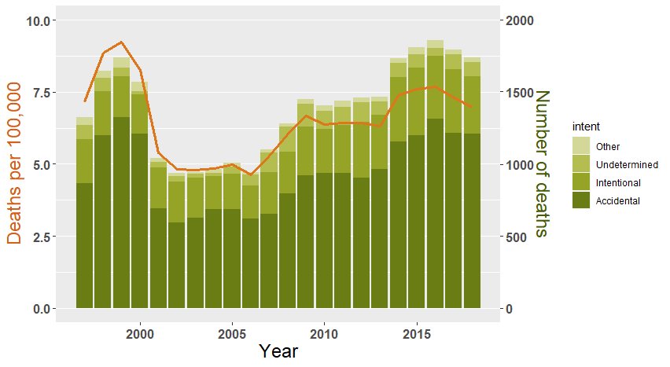
Drug-induced deaths in Australia, all ages, 1997-2018
Preliminary estimate of 1,740 drug-induced deaths in 2018
(1,210 deemed accidental)
35.7% increase in number of deaths
Notes:
Preliminary total of
400 / 23% intentional in 2018
Nicola, can you please calculate the percentage % in number (35.7%) and in rate (15.4%) from 2008 to 2018 and just add to notes only if possible so I can have to hand?
%rate %n Intent
15.4 35.7 All
29.6 52.4 Accidental
17.7 38.4 Intentional
-52.9 -44.6 Undetermined
IRR rate (’18) (’08) n(ratio) n(’18) (’08) Intent
1.15 6.97 6.03 1.36 1740 1282 All
1.30 4.84 3.74 1.52 1210 794 Accidental
1.18 1.60 1.36 1.38 400 289 Intentional
1.17 0.13 0.11 1.38 33 24 Other
0.47 0.39 0.82 0.55 97 175 Undetermined

Slide 6
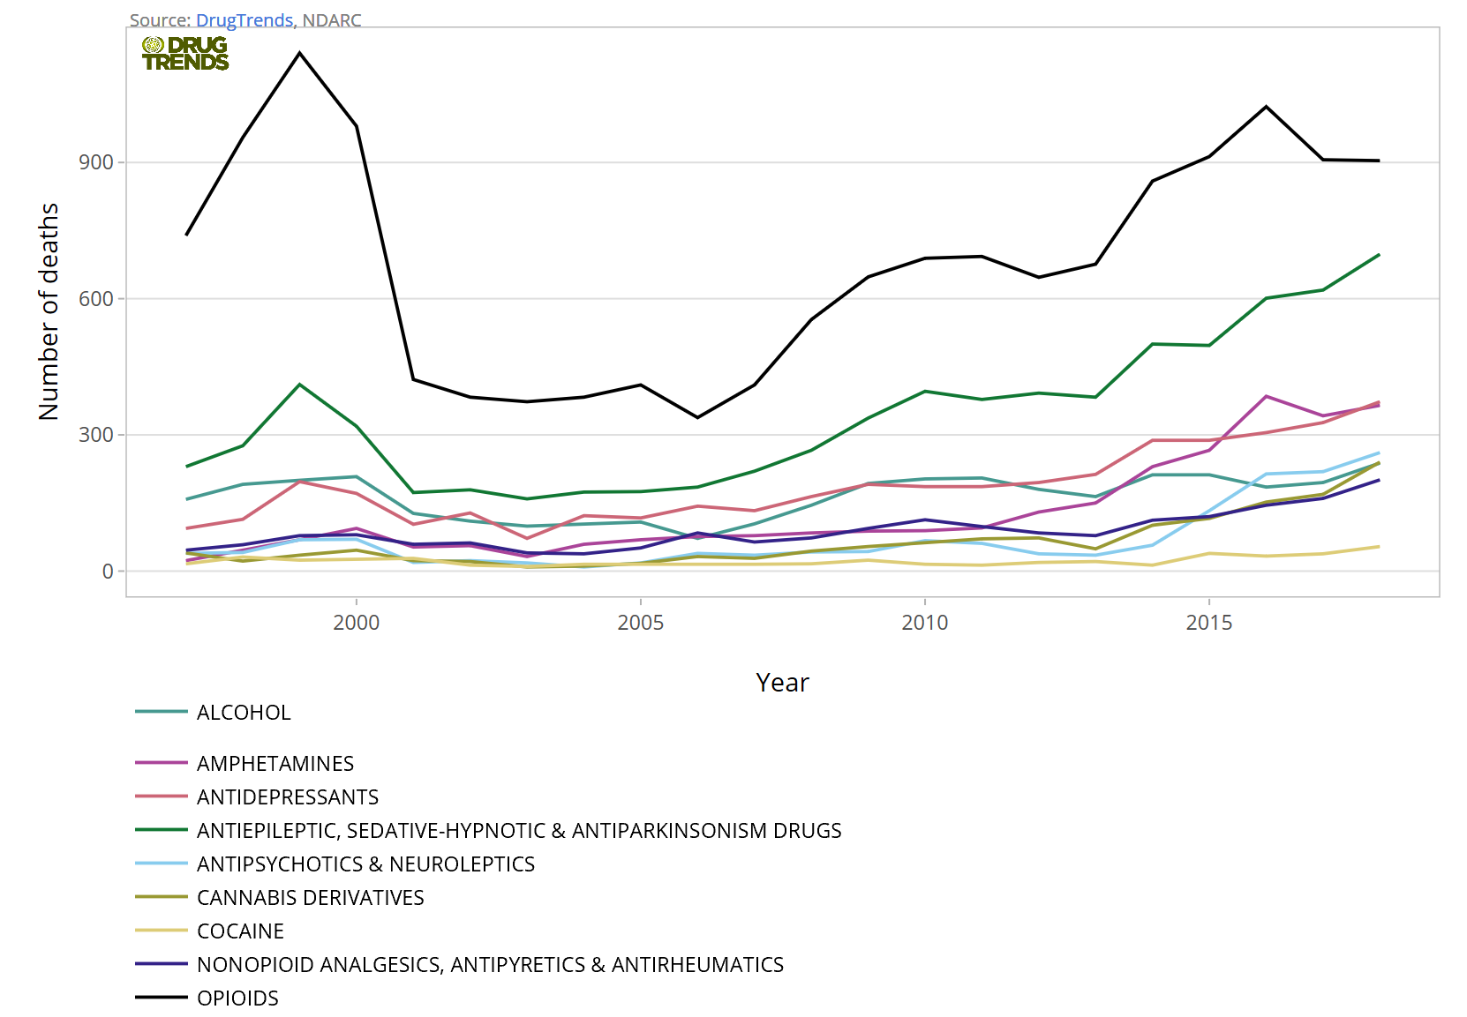
Accidental drug-induced deaths in Australia, all-ages, 1997-2018
Drugs involved in deaths, 2018 | Cases | Per 100,000 people
Opioids | 904 | 3.62
Antiepileptic, sedative-hynpnotic | 698 | 2.79
Antidepress. | 373 | 1.49
Amphetamines | 365 | 1.46
Antipsychotics/ neuroleptics | 261 | 1.04
Cannabis | 240 | 0.96
Alcohol | 238 | 0.95
Non-opioid analgesics | 201 | 0.80
Cocaine | 54 | 0.22
Notes:
Nicola, can you please compute % increase from 2008 to 2018 for each drug class (only if possible)?

Slide 7
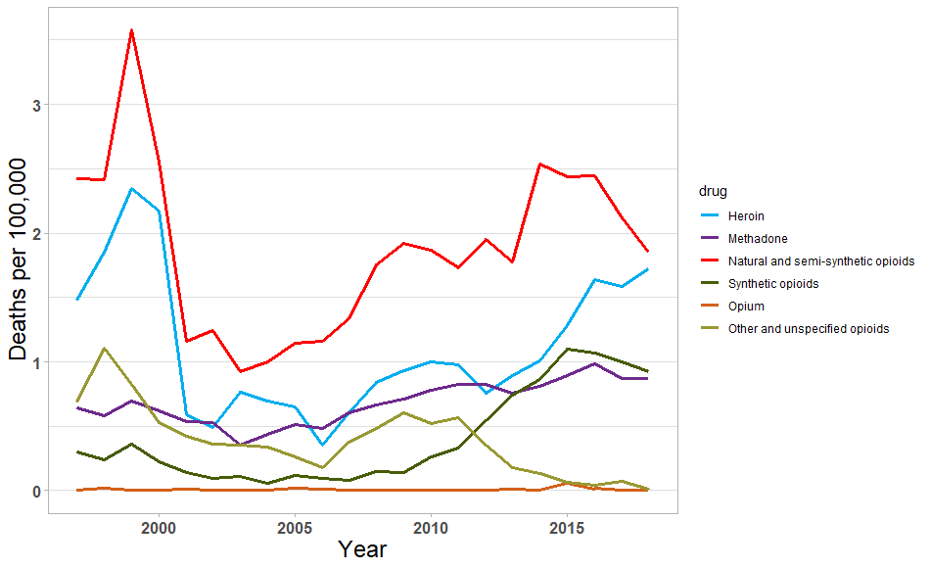
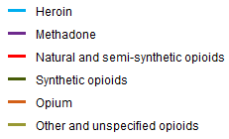
Accidental opioid-induced deaths in Australia by opioid type, all ages, 1997-2018

Slide 8
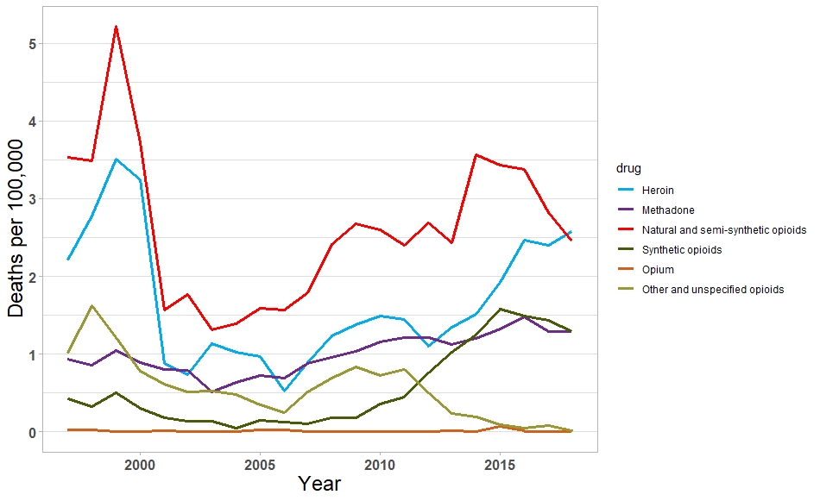
Accidental opioid-induced deaths in Australia by opioid type, 15-64 age group, 1997-2018
Notes:
Not loading but may be because you’re working on them (sorry) – do you mind seeing if you can download?

Slide 9
Naloxone knowledge and training in a national sample of people who inject drugs (Illicit Drug Reporting System)

Slide 10
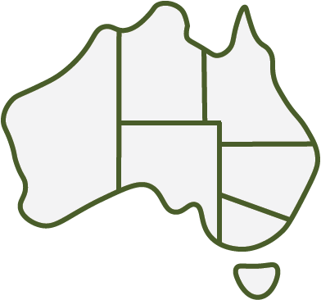
Naloxone knowledge and training in a national sample of people who inject drugs (Illicit Drug Reporting System)
“Have you been trained in naloxone administration?”
15%
reported past 12-month opioid overdose
4%
had been resuscitated by someone who had participated in a take-home naloxone program
47%
who had participated in a training program had used naloxone to reverse overdose
19%
↑27%
33%
8%
↑40%
ACT: 45%
51%
<5%
Notes:
IDRS data is really important for understanding scale of impacts. Improving but still some way to go. Heard from WA and VIC but just wanted to give a national overview, including those jurisdictions which have seen recent progress (at least as indicated by IDRS) in % trained in naloxone

Slide 11


Preventing overdose: food for thought
Non-fatal overdose can lead to significant harms (e.g., brain injury). For discussion: what are the effective strategies for preventing any overdose?
Naloxone
Opioid pharmacotherapy (access, coverage, and retention)
Supervised consumption facilities
Overdose education
Drug checking services (+ information-sharing)
IDRS 2019
1 in 10 people who inject drugs
had ever tested their drugs (11%; 6% in the past year)
Peacock et al. (2019)
Notes:
Because I’m at the end of the series of presentations, I wanted to take advantage of this to perhaps spark some debate about how we respond – not just to preventing fatal overdose, but to preventing overdose full stop. Naloxone will stop loss of life but what about strategies to reduce the risk of any overdose, as we know non-fatal overdose comes with a range of harms, including possible brain injury from lack of oxygen to the brain. Some of these strategies we know have strong evidence base, like naloxone and OAT. Similarly, we know that supervised consumption facilities have been responsible for reversing many many overdoses and for minimising risk of overdose for those who use within these services. Overdose education critical (e.g., not using alone, risks of polysubstance use – things Rose flagged). In the US, seeing growing push towards drug checking services with the issues around unwitting consumption of high potency fentanyl analogues. In Aus, discussion concentrated on festival goers but we do see desire for information about substance contents among people who inject drugs – IDRS results – and there are various organisations involved in or piloting giving people fentanyl testing strips. Something to explore more?

Slide 12
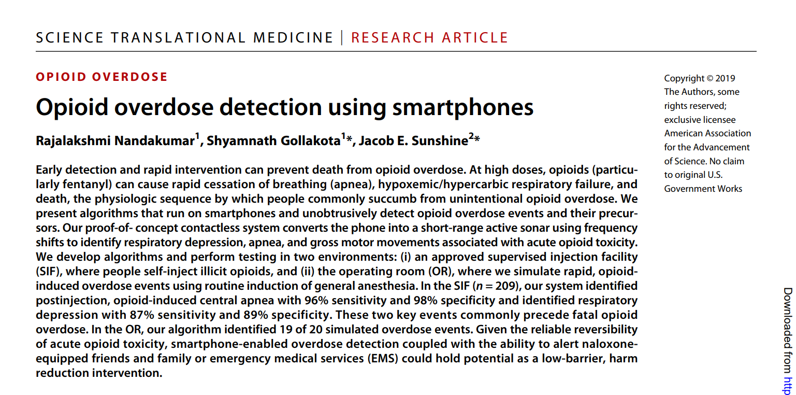
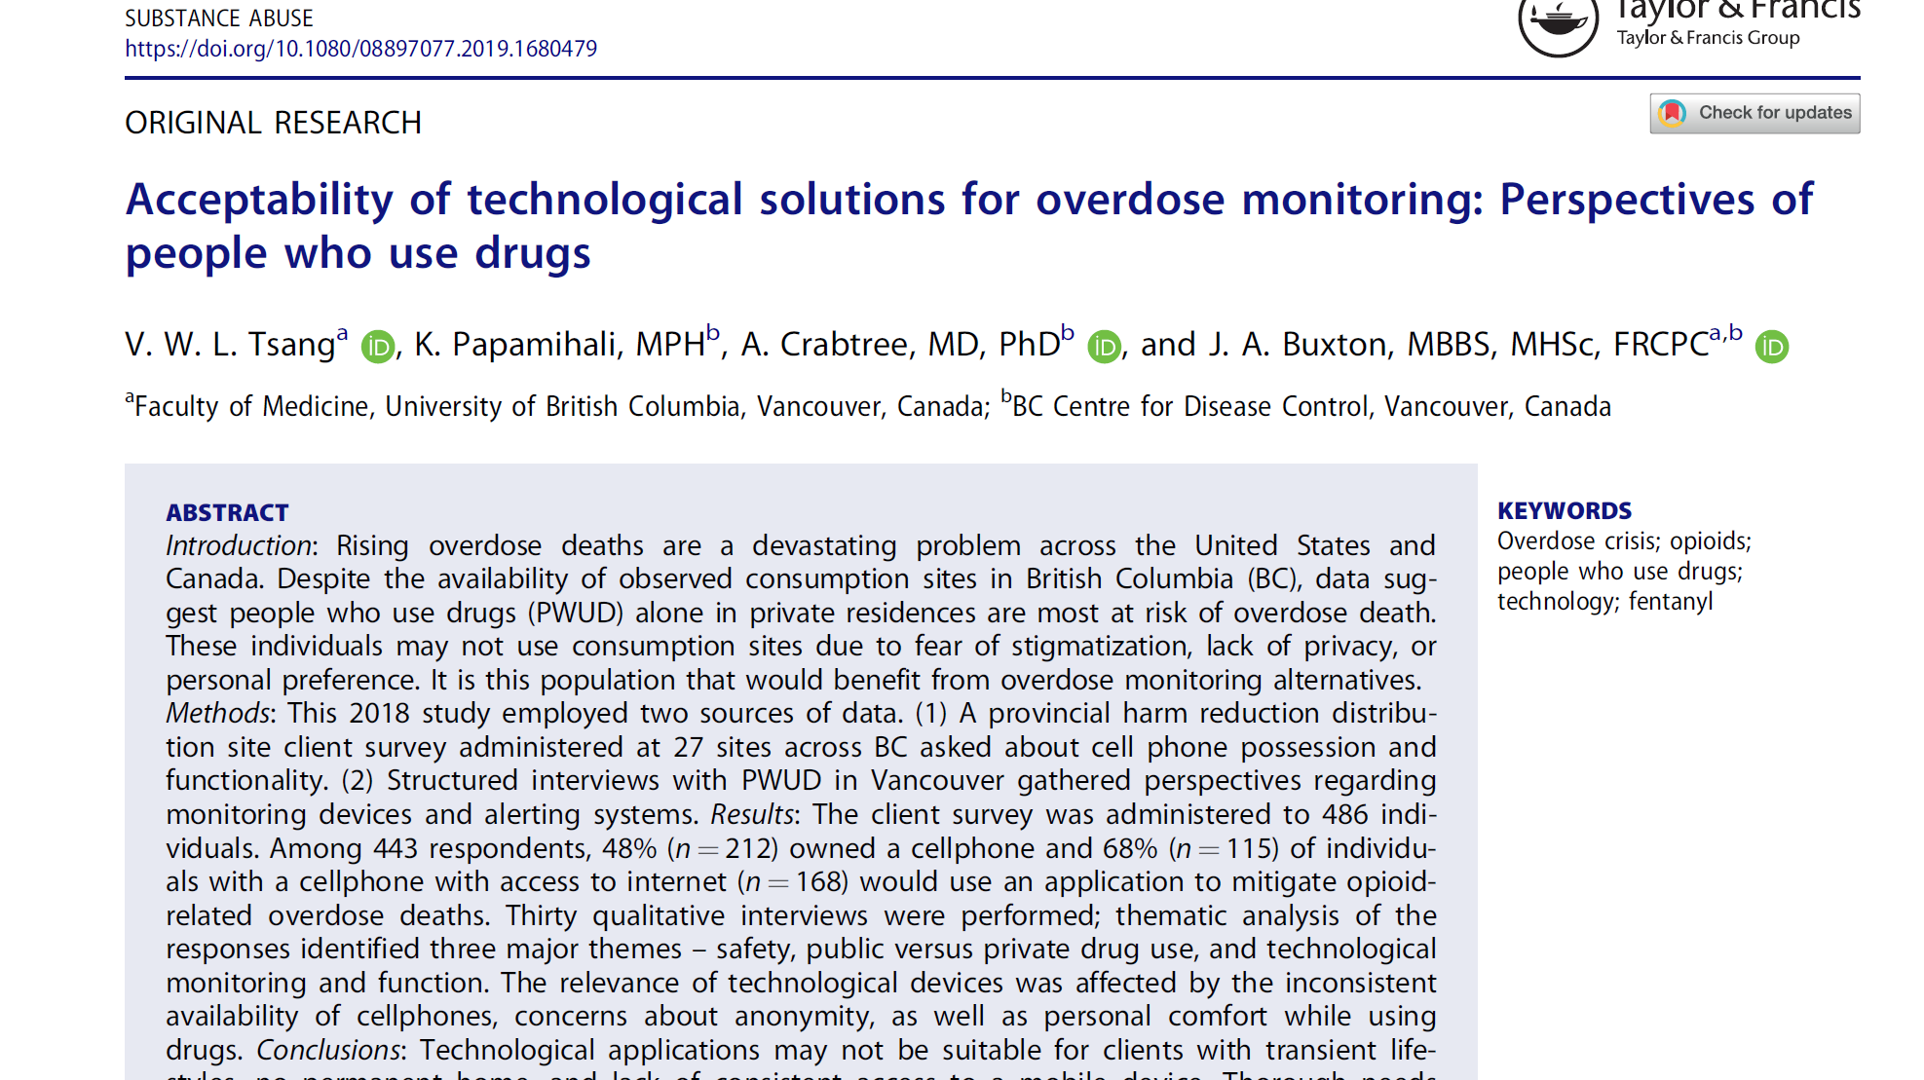
Preventing overdose: food for thought
Non-fatal overdose can lead to significant harms (e.g., brain injury). For discussion: what are the effective strategies for preventing any overdose?
Naloxone
Opioid pharmacotherapy (access, coverage, and retention)
Supervised consumption facilities
Overdose education
Drug checking services (+ information-sharing)
Wearable overdose detection technology
Others? And things we know don’t work?
Notes:
Also seeing growing attention, particularly in the US, on wearable overdose detection technology, for example smartphone apps that act as a short-range active sonar system using frequency shifts to identify respiratory depression, apnea, and gross motor movements associated with acute opioid toxicity. These are very much in the development stage and are not deployed in the real world yet but theoretically on detecting a likely ovedose an alert could be sent to a family member or other third party if the algorithm detected a likely overdose event and the wearer did not respond to an alert. Many issues of acceptability (stigma, alerting authorities, access to mobile phone) but also ethics. And what are the things we know don’t work, and we should make sure our resources etc are not concentrated on?

Slide 13





For further information
2018 deaths data published late Nov/early Dec 2019
  Contact us
  drugtrends@unsw.edu.au
  Go to our website
  https://ndarc.med.unsw.edu.au/program/drug-trends
Check out our interactive visualisation
https://drugtrends.shinyapps.io
Subscribe to our newsletter
https://tinyurl.com/y8g5y7t9
Download our reports
https://ndarc.med.unsw.edu.au/program/drug-trends
@NDARCNEWS #DrugTrends
@ndarcunsw

