Slide 1

National Drug and Alcohol Research Centre
Presentation to Vice Chancellor on visit to meet NDARC Staff
March 2 , 2015

Slide 2
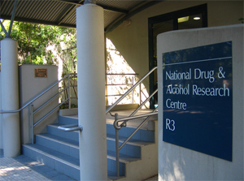
Our Mission
“To conduct and disseminate high quality research and related activities
that increase the effectiveness of responses to alcohol and other drug
related harm”
NDARC Strategic Plan
2012 - 2017

Slide 3
Some History
Established in 1987
Along with NDRI in Perth
An outcome of 1985 Special Premiers’ Conference
Prompted by rising heroin use and crime and discovery of HIV
Started at same time as Kirby Institute
Began from scratch
Very little research on alcohol and drugs in Australia
Some clinicians but no institutional research base
Aim to create research and evidence base capacity for drugs and alcohol in Australia

Slide 4
Current Profile
Staff
49 Academic Staff including 11 NHMRC Fellowships, 2 Rotary Fellowships, 1 VC Post Doctoral Fellowship
70 Professional and Technical Staff
26 Doctoral Candidates
Grant Income
$20M total income
$3.7M Category 1 Income
Centres
Drug Trends and Drug Monitoring, A/Prof Lucy Burns
National Cannabis Information and Prevention Centre, Prof Copeland
Drug Policy Modelling Programme, Prof Alison Ritter
NHMRC Centre for Research on Mental Health and Substance Use, Prof Teesson
National and International Research Collaborations
Key Centre for Global Burden of Disease Collaboration on Illicit Drugs, Prof Degenhardt

Slide 6
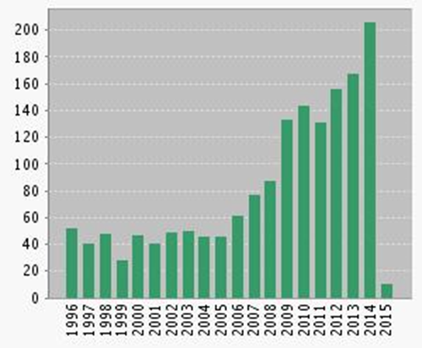
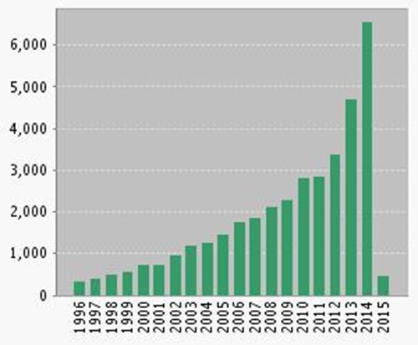
RESEARCH EXCELLENCE NDARC Research Outputs Web of Science
Publications in each year
Citations in each year

Slide 7
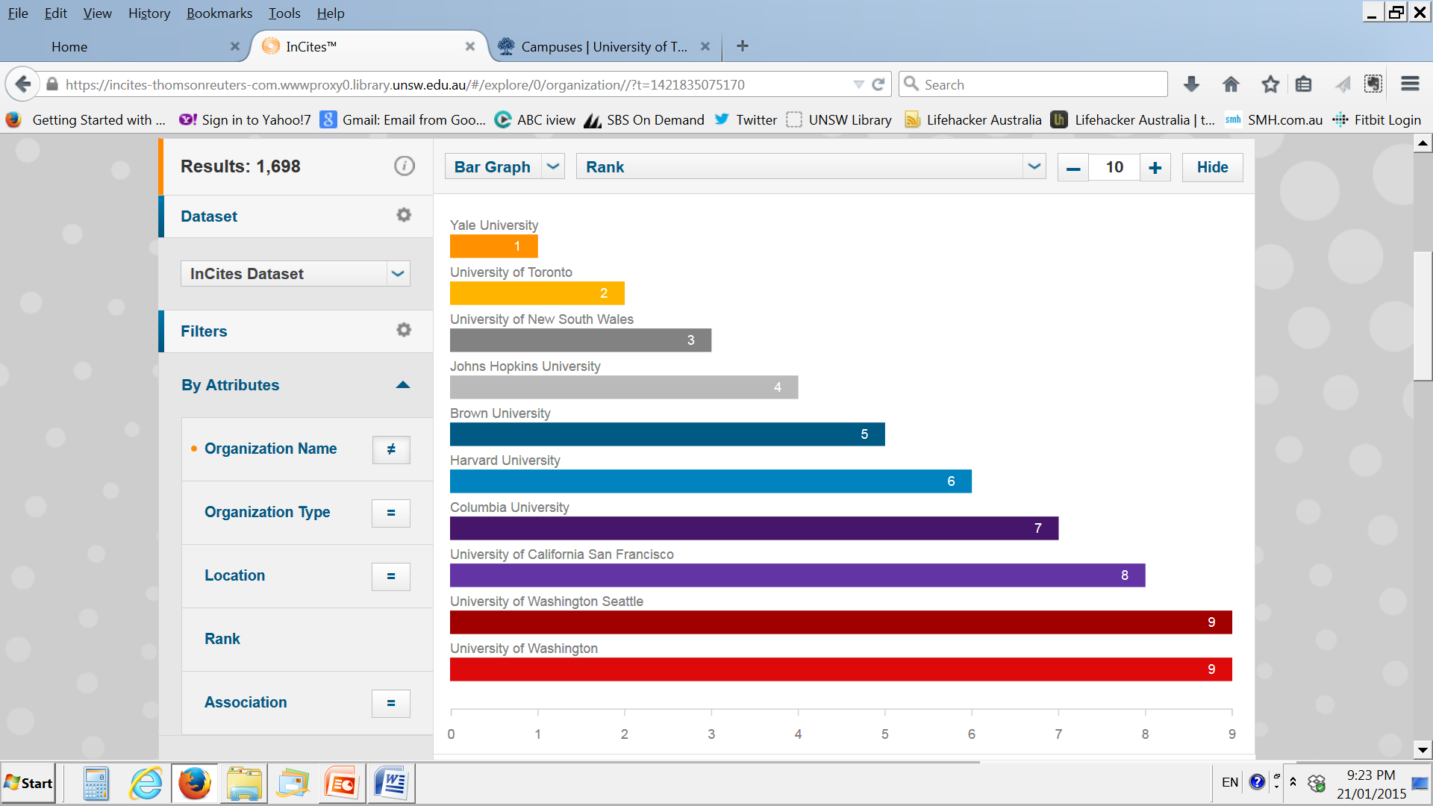
RESEARCH EXCELLENCE Global Ranking of institutions in the research area of substance abuse (excluding NIDA, NIAAA and Confederated Unis) 2010-2014

Slide 8
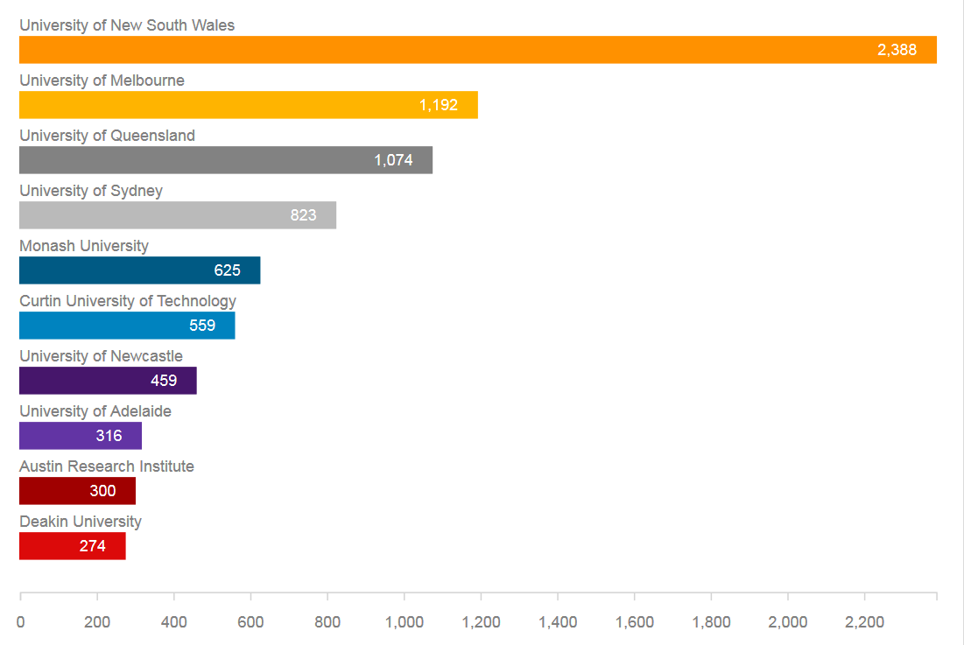
RESEARCH EXCELLENCE Times cited, by Australian institution, 2010-2014

Slide 9
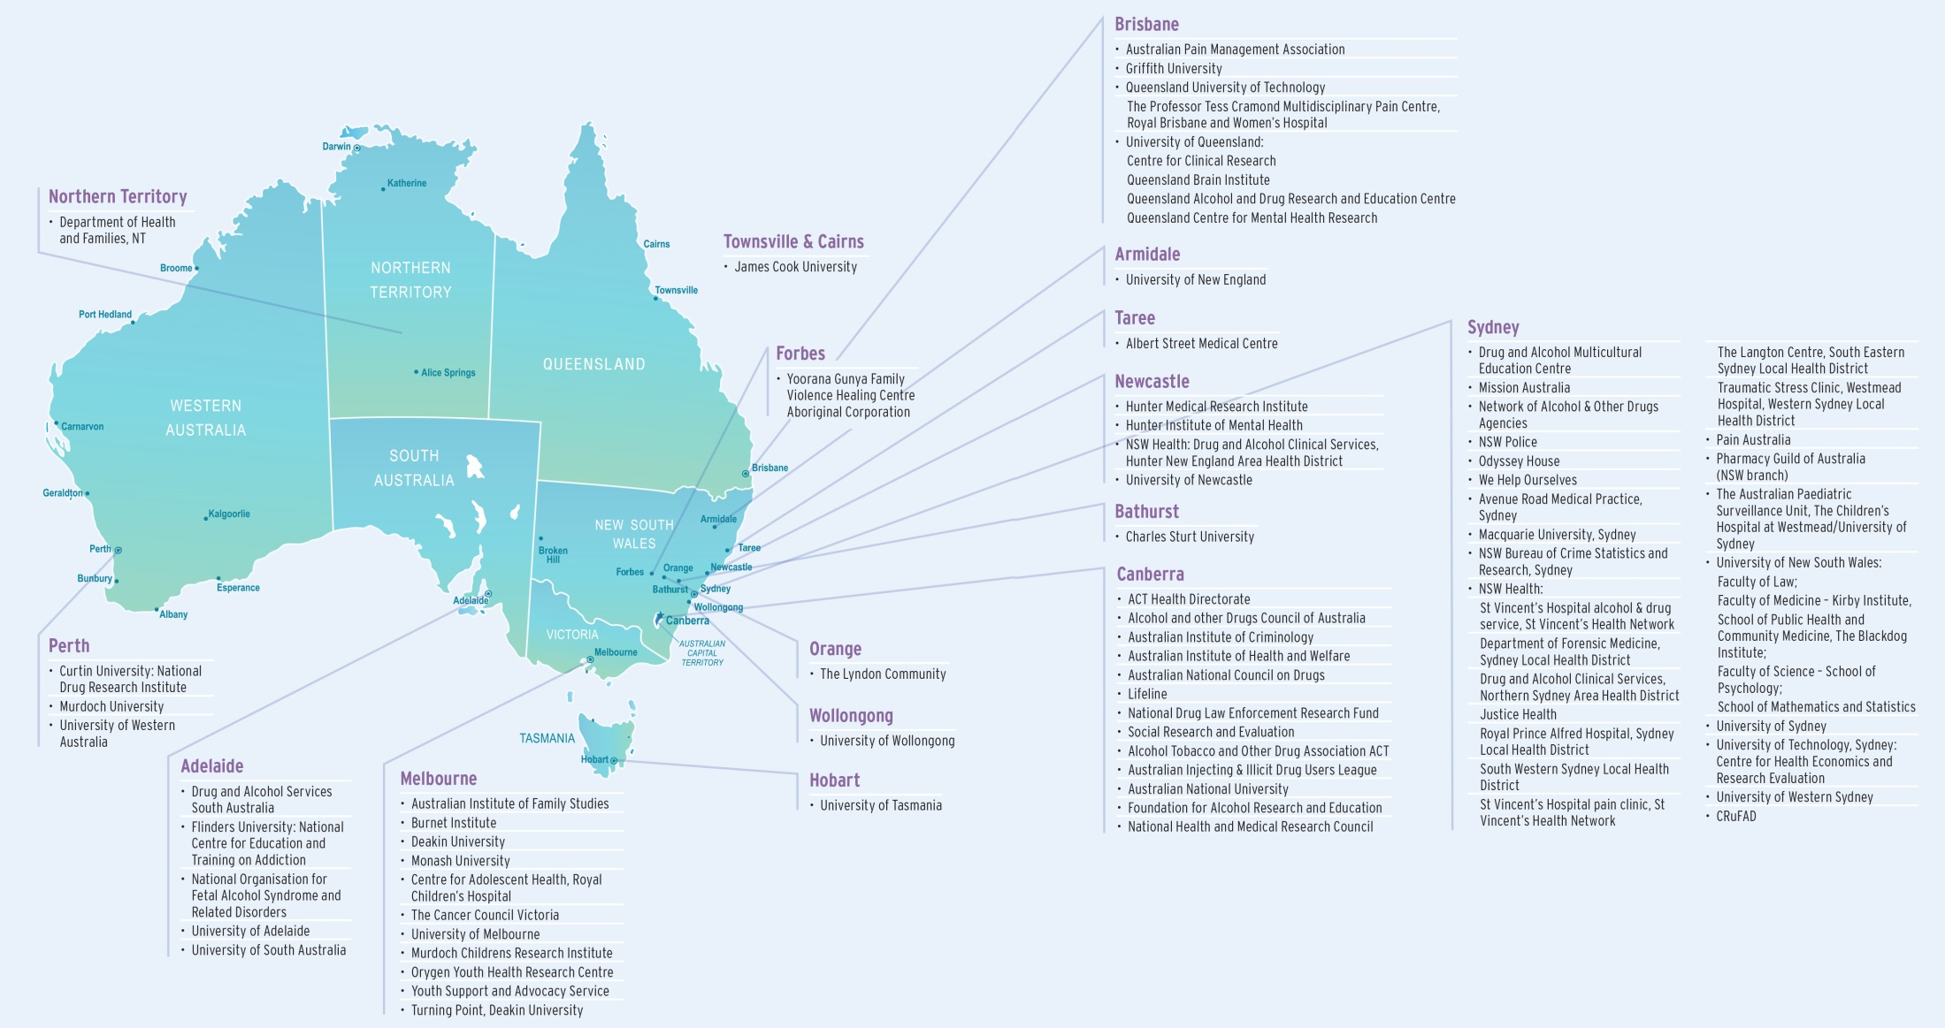
National Collaborators

Slide 10
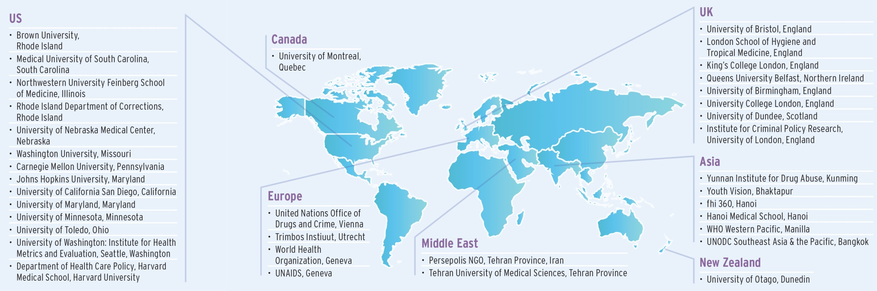
International Collaborators

Slide 11




Building capacity
Education & prevention
Interventions & treatment
Epidemiology
Policy

Slide 12




Research Leaders
Jan Copeland
Improving Evidence base for cannabis prevention and treatment • Cannabis Treatment Evaluation
• Evaluating overall campaign
Shane Darke
Long Term Treatment Outcomes • Risk and Harms • Suicide Prevention in D&A Field
• Psychiatric Comorbidity
Louisa Degenhardt
Global Burden Of Disease • Mortality Related to Opioid Treatment • Post Marketing Surveillance • Data Linkage Methods of Opioid Treatment Entrants • Estimation Studies of Opioid Dependence • Pharmaceutical Opioids • Global Estimates of Injecting Drug Use And HIV
Kate Dolan
Long Term Outcomes from Prison Treatment • Criminal Justice, Hepatitis • HIV &
International Projects

Slide 13




Research Leaders
Richard Mattick
Effects of maternal and paternal alcohol and drug use on child development Neuropharmacology •
Adolescent Alcohol use and parental influence of • Adolescent Longitudinal Cohort Studies to understand risk and resilience
Alison Ritter
Director Drug Policy Modelling Program • Complex modelling • Health Economics *Translational Research.
Anthony Shakeshaft
Community Alcohol Interventions • Large Scale Clustered RCT of alcohol treatment in rural communities over the past five years • Indigenous Issues
Maree Teesson
Centre of Research Excellence on Mental Health and Substance Use • Role of Internet in Treatment alcohol, stimulants and mood disorders • Impact of alcohol on adolescent brain development • Post Traumatic Stress Disorder RCT studies

Slide 14
Global Burden of Disease For tobacco there are 6.30 million deaths in 2010, for alcohol 2.74 million deaths, and for drugs 0.16 million deaths In total in 2010, there were 52.77 million deaths.

Slide 15
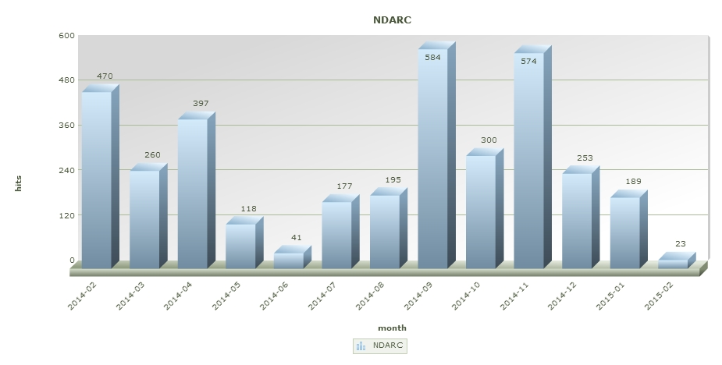
NDARC Media Mentions per month 2014 - 2015

Slide 16
Engagement with Society
Major involvement in National Policy Bodies
National Research Bodies
International Policy Bodies
Learned Societies
Engaged with a comprehensive range of health, social, economic and criminal justice policy issues that relate to tobacco, alcohol and other drug problems.

Slide 17
Challenges
Funding
Federal Government
Research Funding Bodies
University Research Infrastructure
Accommodation
State of the Art on-campus accommodation
Support
Important topic but complexity, social stigma and moral attitudes affect support for research and interventions

Slide 18
Opportunities Vision: Mindgardens to be established as the leading Australian comprehensive centre for behavioural and brain translational research The strengths in UNSW around research on complex behavioural problems and the challenges that society faces with such problems make the opportunities for enhanced collaboration a key approach to improving scale and ambition of research grant getting. Will enhance synergies of a broad range of research groups across the entire campus.

Slide 19
Where do we want to be?
Continued growth of research funding
Undertake major studies that are translated into key findings at
national and global level
Better collaborative links with;
Basic Science Research and Population and Clinical Research
A Major International Research Centre In Collaboration with Mindgardens

Slide 20
How do we get there?
Staff
Support Junior and Mid Career Staff to obtain ongoing Research Funding
New Appointments in Biostats, Health Economics, Neuroethics
Collaboration
Work Closely on Collaboration with research funding becoming more stretched need to collaborate with leading researchers on key topics to ensure the best possible research projects are designed and completed.
Accommodation
New on campus accommodation for NDARC

Slide 21
How Can the Vice Chancellor Help?
We need to make better and stronger case for the importance of
investment in Drug and Alcohol Research at State and Federal Level.
NDARC is the key research centre of Tobacco Drugs and Alcohol in Australia is a key national and a key UNSW assett
We need a strong champion to make this the century in
which the major problems of tobacco, alcohol and drug related community harms are seriously addressed.

