Slide 1






Drug checking and other harm reduction behaviours reported by people who use ecstasy: Findings from the Ecstasy and Related Drugs Reporting System 2019
Amy Peacock, Monica Barratt, Raimondo Bruno, Rachel Sutherland, Caitlin Hughes, Daisy Gibbs, Jodie Grigg, Penny Hill, Julia Uporova, Antonia Karlsson, Georgia Kelly, Paul Dietze, Caroline Salom, Simon Lenton, Louisa Degenhardt & Nadine Ezard

Slide 2
Acknowledgements
Funding:
Australian Government Department of Health
Drug Trends Team:
National Drug and Alcohol Research Centre: Nicola Man, Agata Chrzanowska, Antonia Karlsson, Julia Uporova, Daisy Gibbs, Rosie Swanton, Olivia Price, Louisa Degenhardt, Michael Farrell
Burnet Institute: Amy Kirwan, Cristal Hall, Campbell Aitken, Paul Dietze
School of Medicine, University of Tasmania: Callula Sharman and Raimondo Bruno
National Drug Research Institute: James Fetherston, Jodie Griggs, Seraina Agramunt, Simon Lenton
Institute for Social Science Research, The University of Queensland (QLD): Catherine Daly, Leith Morris, Caroline Salom
Northern Territory Department of Health: Chris Moon
Other Acknowledgements:
IDRS and EDRS participants
Conflicts of interest:
Amy Peacock: untied educational grant from Mundipharma and Seqirus for study of opioid medications
Raimondo Bruno: untied educational grant from Mundipharma and Indivior for study of opioid medications
Louisa Degenhardt: untied educational grant from Mundipharma, Seqirus and Indivior for study of opioid medications
Michael Farrell: untied educational grant from Mundipharma, Seqirus and Indivior for study of opioid medications
Paul Dietze: untied educational grant from Gilead Sciences for HCV research and untied educational grant from Indivior

Slide 3
What do we already know?
People who use illicit drugs often enact harm reduction strategies based on their understanding of the likely contents and dose (Fernandez-Calderon et al., 2019).
A growing body of research documents among people who use illicit drugs:
  willingness to obtain information about the contents of their illicit drugs (Palamar & Barratt, 2019); and
  support for drug checking services which offer testing to objectively determine contents of illicit substances (Barratt et al., 2018).
In Australia, there are no local government-sanctioned drug-checking services available with the exception of two on-site trials at a music festival in Canberra, Australia (Makkai et al., 2018; Vumbaca et al., 2019).
Notes:
Illicit drug market is unregulated, which means that substance contents can vary substantially.

Slide 4
What are the methods which can be used to objectively test illicit drugs?
Table reproduced from Harper et al. (2017).
 | Identify drug | Quantify drug | Ease of use | Cost
Most discriminatory
Mass spectrometry | ✓ | ✓ | Intermediate-advanced | $$$$$
Infrared spectrometry | ✓ | ✓ | Basic-advanced | $$$$
Raman spectroscopy | ✓ | ✓ | Basic-advanced | $$$$
X-ray diffractometry | ✓ | ✓ | Advanced-expert | $$$$$
Least discriminatory
Thin-layer chromatography | ✓ |  | Basic-intermediate | $$$
Ultraviolet spectroscopy | ✓ |  | Basic-intermediate | $$$
Reagent test | ✓ |  | Basic-intermediate | $$
Microcrystalline tests | ✓ |  | Intermediate-advanced | $$
Immunoassay | ✓ |  | Intermediate-advanced | $$$
Urine dipstick test | ✓ |  | Basic-intermediate | $

Slide 5
What are the methods which can be used to objectively test illicit drugs?
Table reproduced from Harper et al. (2017).
 | Identify drug | Quantify drug | Ease of use | Cost
Most discriminatory
Mass spectrometry | ✓ | ✓ | Intermediate-advanced | $$$$$
Infrared spectrometry | ✓ | ✓ | Basic-advanced | $$$$
Raman spectroscopy | ✓ | ✓ | Basic-advanced | $$$$
X-ray diffractometry | ✓ | ✓ | Advanced-expert | $$$$$
Least discriminatory
Thin-layer chromatography | ✓ |  | Basic-intermediate | $$$
Ultraviolet spectroscopy | ✓ |  | Basic-intermediate | $$$
Reagent test | ✓ |  | Basic-intermediate | $$
Microcrystalline tests | ✓ |  | Intermediate-advanced | $$
Immunoassay | ✓ |  | Intermediate-advanced | $$$
Urine dipstick test | ✓ |  | Basic-intermediate | $

Slide 6
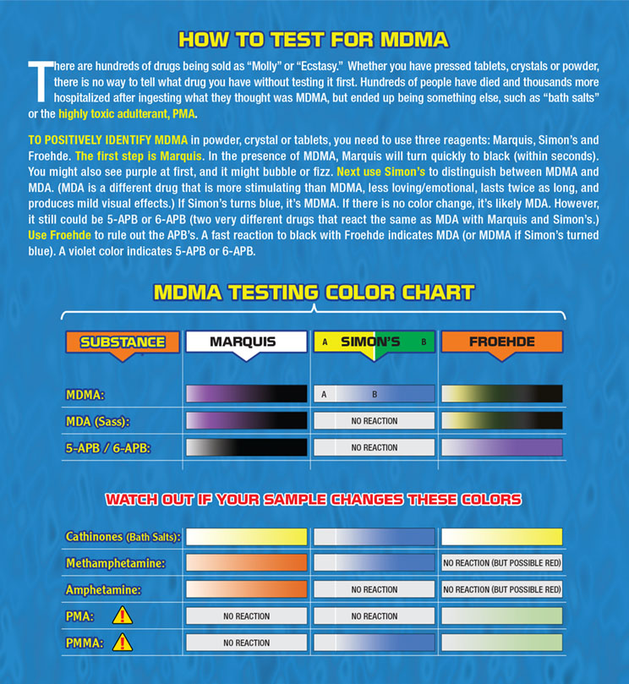
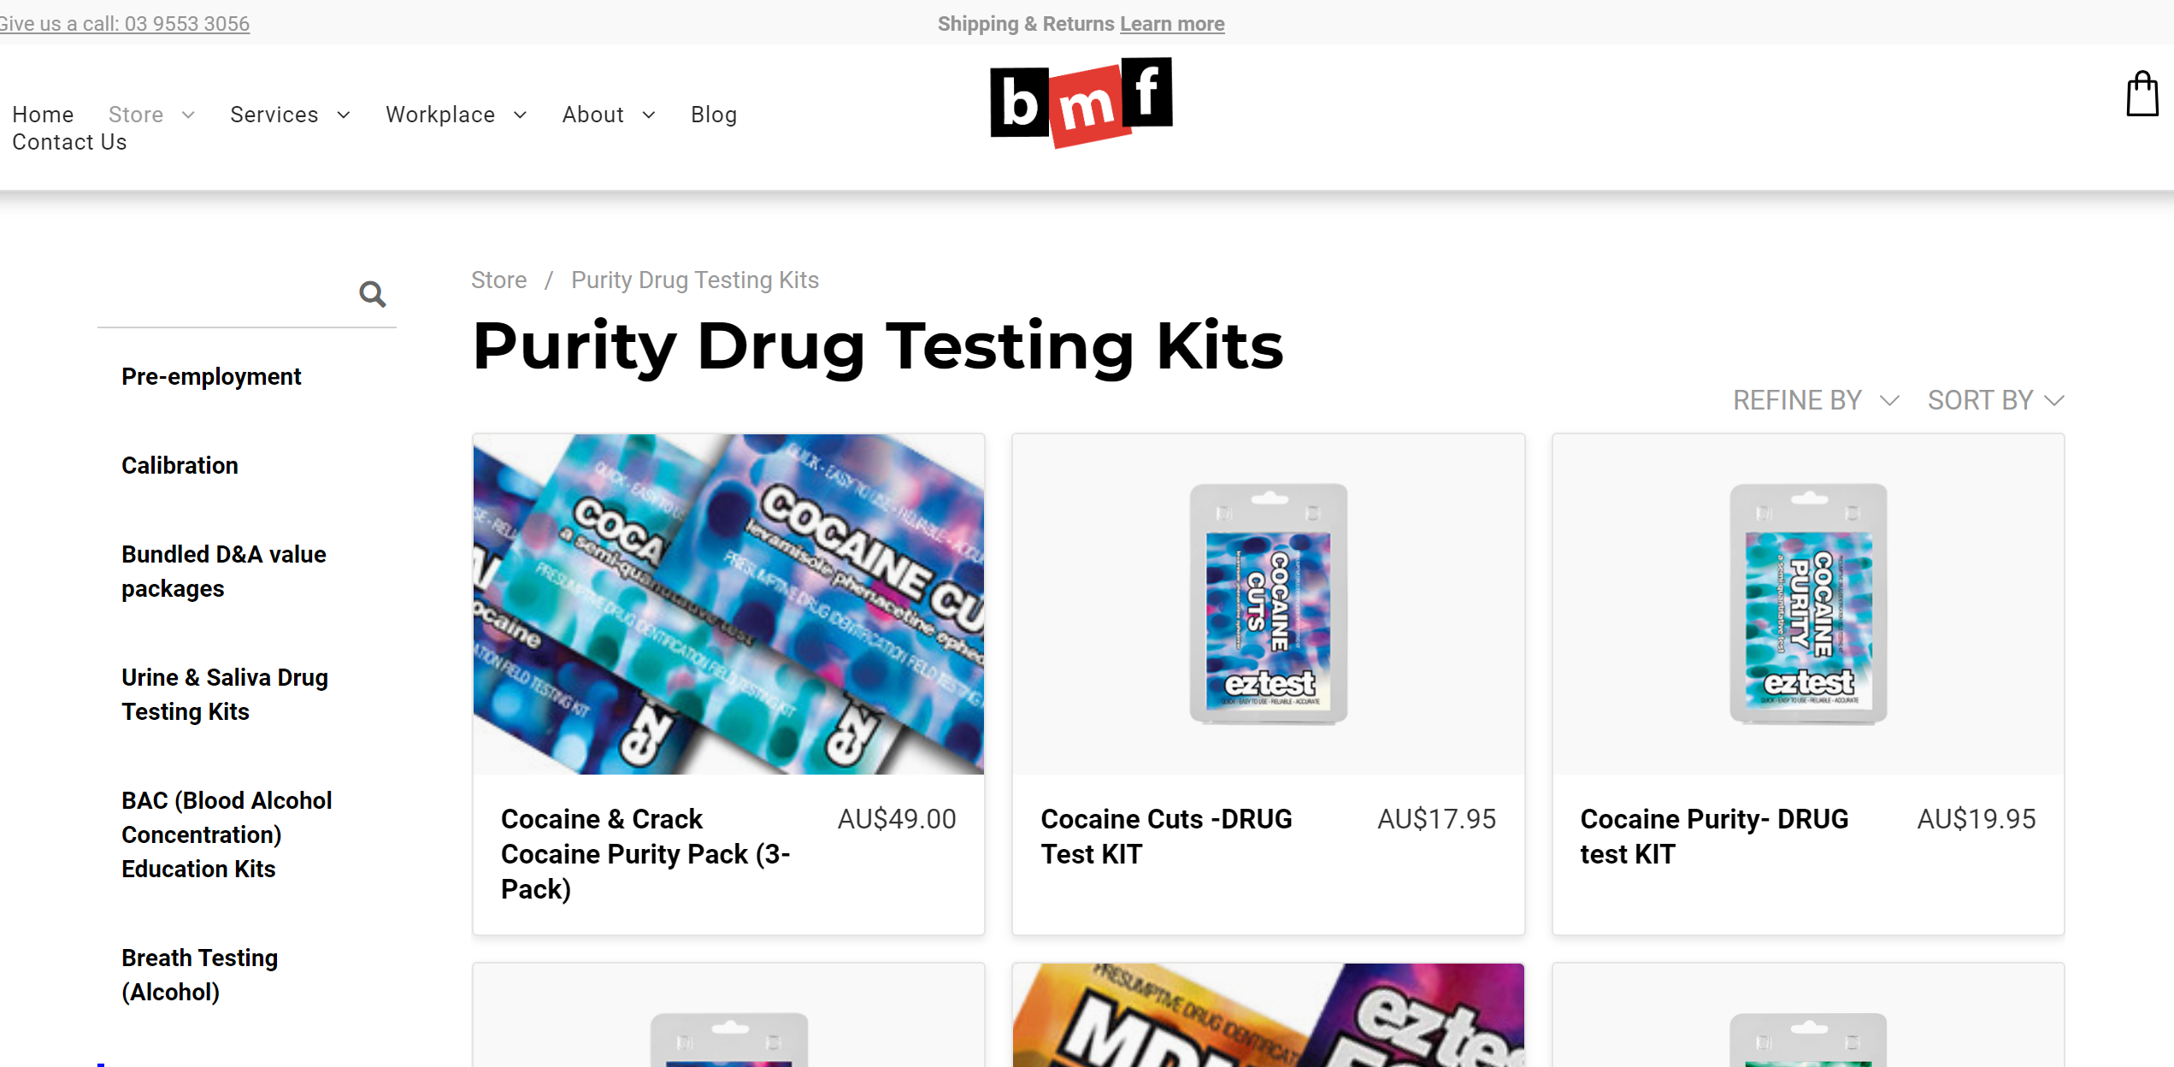
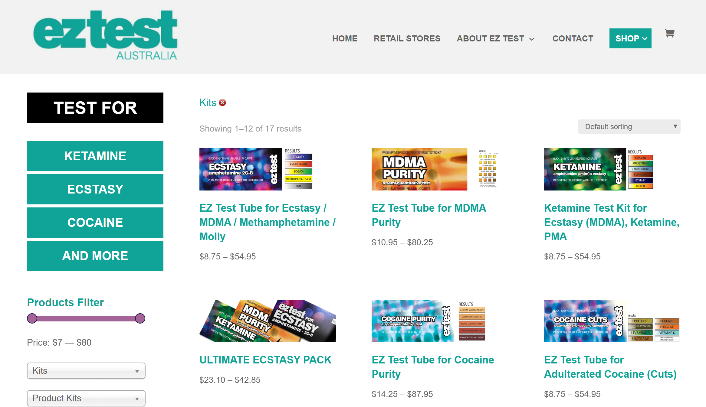
Personal testing kits (e.g., colour reagent tests)

Slide 7
Personal testing kits (e.g., colour reagent tests)
23%
Of people who use ecstasy recruited from the New York electronic dance music scene had tested their ecstasy using reagent test kits in the past year
51%
Had found out or suspected their ecstasy contained a drug other than MDMA
(Palamar & Barratt, 2019)
84%
of people who use ecstasy in Australia interviewed in 2006 had attempted to find out content/purity of ecstasy
22%
Of these had personally used a reagent testing kit (+ others reporting friend/dealer using kit)
(Johnston et al., 2006)
AIMS:
Use of drug checking technologies among people who regularly use ecstasy and people who regularly inject drugs; and
2. Behavioural responses to receipt of results
3. Other behaviours that may reduce risk of harm
Notes:
Both previous surveys have focused on hypothetical responses

Slide 8
IDRS and EDRS interview samples, 2019
 | Illicit Drug Reporting System (N=902) | Ecstasy and related Drugs Reporting System (N=797)
Eligibility criteria: | People who regularly inject illicit drugs residing in capital cities | People who regularly use ecstasy or other stimulants residing in capital cities
Interviewed: | May-July 2019 | April-July 2019
Recruited | Needle-syringe programs, word-of-mouth across all capital cities | Social media and word-of-mouth Needle-syringe programs, word-of-mouth
Demographics: | Mostly male (68%) and middle-aged (median 43 years) | Mostly male (60%) and young (median 22 years old)
 | Majority unemployed (88%) | Majority studying (45%) and/or employed (73%)
 | Unstable housing high (9%) | Few in unstable housing (1%)
 | History of incarceration high (62%) | History of incarceration lower (5%)
 | Two in five (41%) in drug treatment | Few in drug treatment (6%)

Slide 9
Results: Self-reported drug checking
 | Sample who use ecstasy %(n) | Sample who inject drugs %(n)
“Have you or someone else ever tested the content and/or purity of your illicit drugs?” | N=792 | N=883
No | 55% (435) | 89% (784)
Yes, but not in the past year | 9% (73) | 6% (50)
Yes, in the past year | 36% (284) | 6% (49)
Of those who had tested in the last year: “Last time your illicit drugs were tested, how were they tested?” | n=284 | n=49
Personal testing kit (e.g., colorimetric/reagent test) | 86% (244) | 61% (30)
Testing strips | 1% (4) | 11% (5)
Face-to-face testing service | 4% (11) | 4% (2)
Postal/online testing service | 1% (3) | 2% (1)
Other/Don’t know | 8% (22) | 22% (11)

Slide 10
Results: Last occasion of using a reagent kit
(sample who use ecstasy; n=244)

Slide 11
Results: Last occasion of using a reagent kit
(sample who use ecstasy; n=244)
“What kind of test was conducted?”
47%
testing for the presence of one substance
37%
testing for the presence of multiple substances
23%
testing for quantity of substance
38%
testing for presence of adulterants/cutting agents
(note 7% responded ‘don’t know’)
“What was the drug sold/given to you as?”
33%
Ecstasy/MDMA crystal
30%
Ecstasy/MDMA capsule
17%
Ecstasy/MDMA pill
6%
Cocaine
13%
Other drug
(e.g., ketamine, methamphet., LSD)

Slide 12
Results: Last occasion of using a reagent kit on ecstasy (sample who use ecstasy; n=140)
 | Expected but did not detect MDMA (n=13) | Expected and detected MDMA (n=131)
Used the tested drug | 46% (6) | 95% (124)
Did not use the tested drug | 31% (4) | 3% (4)
Still have the drug and plan to use in future | 15% (2) | 8% (11)
Gave/sold them to someone else | 15% (2) | 24% (31)
Reported results to peers | 31% (4) | 29% (38)
Reported results to dealer | 31% (4) | 11% (14)
Destroyed/disposed substance | 15% (2) | <1% (1)
Warning: Small sample!

Slide 13
Potential harm reduction behaviours on last occasion of stimulant use (sample who use ecstasy; N=797)
Prior to use:
62% made sure they had eaten adequately before
61% spoke with peers who had already tried substance from the same batch
55% rested the night before
26% searched online interactions between drugs they intended to use
25% searched the drug online
22% used vitamin supplements
During the session:
80% ensured they were with people who knew they were using drugs
76% consumed water regularly
61% spread out doses
40% took regular breaks to stay cool
17% started with a smaller amount to see what it was like
Notes:
Note we did assess a range of behaviours which may increase risk too

Slide 14
Conclusions
People who use illicit drugs do engage in a range of behaviours to reduce their risk of harm before and after consuming illicit drugs.
Findings suggest people want objective information about contents of illicit drugs - and for more substances than ecstasy ‘pills’.
  People who inject drugs may be a relatively overlooked population in current debate around ‘pill-testing’/drug checking.
Most people who had used a reagent kit on a substance acquired as ‘ecstasy/MDMA’ identified MDMA and then used the substance.
  Behavioural responses to receipt of results may differ with methodologies that provide full information about contents/dose and with provision of harm reduction information from service provider.
  Not necessarily an individual-level intervention – testing often conducted with others and results shared with others – broader impacts.
Notes:
And also setting – concentrated on the festival environment but equal access to people who use drugs (e.g.,

Slide 15
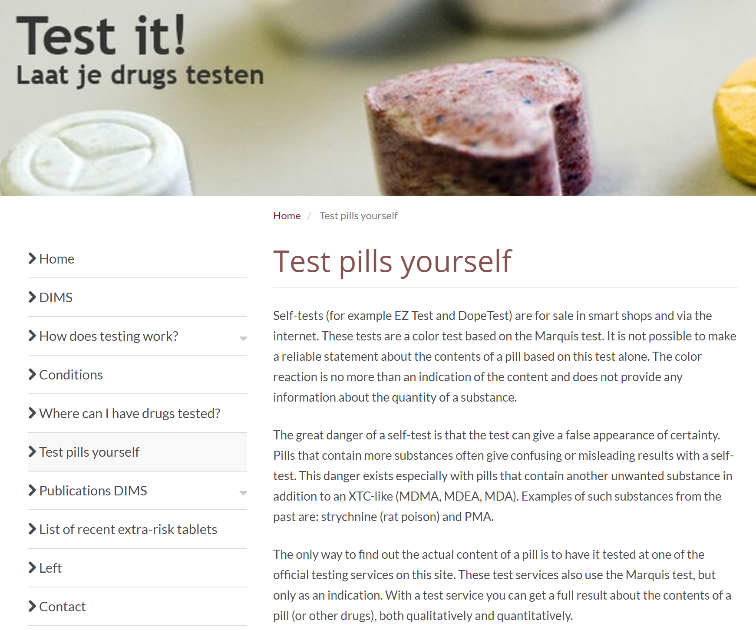
Conclusions
4. Reagent testing kits are a legal, relatively cheaper means of drug checking likely being used by a substantial minority of those who use ecstasy and related drugs.
  Do not reliably identify all substances contained nor dose;
  Potentially poor awareness of limitations of reagent testing; and
  Mostly no face-to-face contact to facilitate linking in with other services/provision of other harm reduction info.
What can be done to address some of the above issues (and in the absence of drug-checking services accessible to all who may wish to use)?

Slide 16
Limitations and Next Steps
Key Limitations
Retrospective self-report
Exploratory data collection for people who inject drugs
Behaviour may differ with provision of information on all contents/dose and with harm reduction information
Next Steps: EDRS 2020 Interview
Awareness of limitations of reagent testing kits
Using multiple kits
Platforms and means for risk communication
Suggestions welcome!
Notes:
In saying this, for people who inject drugs price may be out of the park – can cost up to 80-100 to conduct multiple ests

Slide 17





For further information
  Contact us
  Amy.peacock@unsw.edu.au
  drugtrends@unsw.edu.au
  Website
  https://ndarc.med.unsw.edu.au/program/drug-trends
Subscribe to our newsletter
https://tinyurl.com/y8g5y7t9
Download our reports
https://ndarc.med.unsw.edu.au/program/drug-trends
@NDARCNEWS #DrugTrends
@ndarcunsw

