Slide 1






Findings from the Australian Capital Territory 2019 Illicit Drug Reporting System

Slide 2
Figure 1: Drug of choice, ACT, 2000-2019
Note. Substances listed in this figure are the primary endorsed; nominal percentages have endorsed other substances. Data labels have been removed from figures in years 2000, 2017 and 2018 with small cell size (i.e. n≤5). *p<0.050; **p<0.010; ***p<0.001 for 2018 versus 2019.

Slide 3
Figure 2: Drug injected most often in the past month, ACT, 2000-2019
Note. Substances listed in this figure are the primary endorsed; nominal percentages have endorsed other substances. Data labels have been removed from figures in years 2000, 2017 and 2018 with small cell size (i.e. n≤5). *p<0.050; **p<0.010; ***p<0.001 for 2018 versus 2019

Slide 4
Figure 3: Weekly or more frequent substance use in the past six months, ACT, 2000-2019
Note. These figures are of the entire sample. Y axis reduced to 80% to improve visibility of trends. *p<0.050; **p<0.010; ***p<0.001 for 2018 versus 2019.

Slide 5
Figure 4: Past six month use and frequency of use of heroin, ACT, 2000-2019
Note. Median days computed among those who reported recent use (maximum 180 days). Median days rounded to the nearest whole number. *p<0.050; **p<0.010; ***p<0.001 for 2018 versus 2019

Slide 6
Figure 5: Median price of heroin per cap and gram, ACT, 2000-2019
Note. Among those who commented. Price for a gram of heroin was not collected in 2000. *p<0.050; **p<0.010; ***p<0.001 for 2018 versus 2019.

Slide 7
Figure 6: Current perceived purity of heroin, ACT, 2000-2019
Note. The response ‘Don’t know’ was excluded from analysis. Data labels have been removed from figures throughout all years with small cell size (i.e. n≤5). *p<0.050; **p<0.010; ***p<0.001 for 2018 versus 2019.

Slide 8
Figure 7: Current perceived availability of heroin, ACT, 2000-2019
Note. The response ‘Don’t know’ was excluded from analysis. Data labels have been removed from figures throughout all years with small cell size (i.e. n≤5). *p<0.050; **p<0.010; ***p<0.001 for 2018 versus 2019.

Slide 9
Figure 8: Past six month use of any methamphetamine, powder, base, and crystal, ACT, 2000-2019
Note. # Base asked separately from 2001 onwards. ‘Any methamphetamine’ includes crystal, speed, base and liquid methamphetamine combined. Figures for liquid not reported historically due to small numbers, however in 2018 3% of the national sample reported use of liquid amphetamine in the six months preceding interview. *p<0.050; **p<0.010; ***p<0.001 for 2018 versus 2019.

Slide 10
Figure 9: Frequency of use of any methamphetamine, powder, base, and crystal, ACT, 2000-2019
Note. Median days computed among those who reported recent use (maximum 180 days). Median days rounded to the nearest whole number. Y axis reduced to 80 to improve visibility of trends. Median days used base and crystal not collected in 2000-2001. Data labels have been removed from figures in years 2000, 2017 and 2018 with small cell size (i.e. n≤5). *p<0.050; **p<0.010; ***p<0.001 for 2018 versus 2019.

Slide 11
Figure 10: Median price of powder methamphetamine per point and gram, ACT, 2002-2019
Note. Among those who commented. *p<0.050; **p<0.010; ***p<0.001 for 2018 versus 2019. No respondents for the price of a gram in 2017

Slide 12
Figure 11: Current perceived purity of powder methamphetamine, ACT, 2002-2019
Note. Methamphetamine asked separately for the three different forms from 2002 onwards. The response ‘Don’t know’ was excluded from analysis. Data labels have been removed from figures throughout all years with small cell size (i.e. n≤5). *p<0.050; **p<0.010; ***p<0.001 for 2018 versus 2019.

Slide 13
Figure 12: Current perceived availability of powder methamphetamine, ACT, 2002-2019
Note. Methamphetamine asked separately for the three different forms from 2002 onwards. The response ‘Don’t know’ was excluded from analysis. Data labels have been removed from figures throughout all years with small cell size (i.e. n≤5). *p<0.050; **p<0.010; ***p<0.001 for 2018 versus 2019.

Slide 14
Figure 13: Median price of crystal methamphetamine per point and gram, ACT, 2002-2019
Note. Among those who commented. No data available for gram in 2001. *p<0.050; **p<0.010; ***p<0.001 for 2018 versus 2019.

Slide 15
Figure 14: Current perceive purity of crystal methamphetamine, ACT, 2002-2019
Note. Methamphetamine asked separately for the three different forms from 2002 onwards. The response ‘Don’t know’ was excluded from analysis. Data labels have been removed from figures throughout all years with small cell size (i.e. n≤5). *p<0.050; **p<0.010; ***p<0.001 for 2018 versus 2019.

Slide 16
Figure 15: Current perceived availability of crystal methamphetamine, ACT, 2002-2019
Note. Methamphetamine asked separately for the three different forms from 2002 onwards. The response ‘Don’t know’ was excluded from analysis. Data labels have been removed from figures throughout all years with small cell size (i.e. n≤5). *p<0.050; **p<0.010; ***p<0.001 for 2018 versus 2019.

Slide 17
Figure 16: Past six month use and frequency of use of cocaine, ACT, 2000-2019
Note. Median days computed among those who reported recent use (maximum 180 days). Median days rounded to the nearest whole number. Y axis reduced to 10 to improve visibility of trends. Data labels have been removed from figures in years 2000, 2017 and 2018 with small cell size (i.e. n≤5). *p<0.050; **p<0.010; ***p<0.001 for 2018 versus 2019.
Notes:
‘2019’ not showing

Slide 18
Figure 17: Past six month use and frequency of use of cannabis, ACT, 2000-2019
Note. Median days computed among those who reported recent use (maximum 180 days). Median days rounded to the nearest whole number. *p<0.050; **p<0.010; ***p<0.001 for 2018 versus 2019.

Slide 19
Figure 18: Median price of hydroponic (a) and bush (b) cannabis per ounce and gram, ACT, 2003-2019
(A) Hydroponic cannabis
(B) Bush cannabis
Note. Among those who commented. From 2003 onwards hydroponic and bush cannabis data collected separately. No data available for ounce in 2000 and 2001.

Slide 20
Figure 19: Current perceived potency of hydroponic (a) and bush (b) cannabis, ACT, 2004-2019
(A) Hydroponic cannabis
(B) Bush cannabis
Note. The response ‘Don’t know’ was excluded from analysis. Hydroponic and bush cannabis data collected separately from 2004 onwards. Data labels have been removed from figures throughout all years with small cell size (i.e. n≤5). *p<0.050; **p<0.010; ***p<0.001 for 2018 versus 2019.

Slide 21
Figure 20: Current perceived availability of hydroponic (a) and bush (b) cannabis, ACT, 2004-2019
(A) Hydroponic cannabis
(B) Bush cannabis
Note. The response ‘Don’t know’ was excluded from analysis. * Hydroponic and bush cannabis data collected separately from 2004 onwards. Data labels have been removed from figures throughout all years with small cell size (i.e. n≤5). *p<0.050; **p<0.010; ***p<0.001 for 2018 versus 2019.

Slide 22
Figure 21: Past six month use (prescribed and non-prescribed) and frequency of use of methadone, ACT, 2000-2019
Note. Includes methadone syrup and tablets. Non-prescribed use not distinguished 2000-2002. Median days computed among those who reported recent use (maximum 180 days). Median days rounded to the nearest whole number. *p<0.050; **p<0.010; ***p<0.001 for 2018 versus 2019.

Slide 23
Figure 22: Past six month use (prescribed and non-prescribed) and frequency of use of buprenorphine, ACT, 2002-2019
Note. Median days computed among those who reported recent use (maximum 180 days). Median days rounded to the nearest whole number. Data labels have been removed from figures in years 2002, 2017 and 2018 with small cell size (i.e. n≤5). *p<0.050; **p<0.010; ***p<0.001 for 2018 versus 2019.

Slide 24
Figure 23: Past six month use (prescribed and non-prescribed) and frequency of use of buprenorphine-naloxone, ACT, 2006-2019
Note. From 2006-2011 participants were asked about the use of buprenorphine-naloxone tablet; from 2012-2015 participants were asked about the use of buprenorphine-naloxone tablet and film; from 2016- 2018 participants were asked about the use of buprenorphine–naloxone film only. Median days computed among those who reported recent use (maximum 180 days). Median days rounded to the nearest whole number. Y axis reduced to 100 to improve visibility of trends. Data labels have been removed from figures in years 2006, 2017 and 2018 with small cell size (i.e. n≤5). *p<0.050; **p<0.010; ***p<0.001 for 2018 versus 2019.

Slide 25
Figure 24: Past six month use (prescribed and non-prescribed) and frequency of use of morphine, ACT, 2001-2019
Note. Median days computed among those who reported recent use (maximum 180 days). Median days rounded to the nearest whole number. Data labels have been removed from figures in years 2001, 2017 and 2018 with small cell size (i.e. n≤5). *p<0.050; **p<0.010; ***p<0.001 for 2018 versus 2019.

Slide 26
Figure 25: Past six month use (prescribed and non-prescribed) and frequency of use of oxycodone, ACT, 2005-2019
Note. From 2005-2015 participants were asked about any oxycodone; from 2016-2018, oxycodone was broken down into three types: tamper resistant (‘OP’), non-tamper proof (generic) and ‘other oxycodone’. Median days computed among those who reported recent use (maximum 180 days). Median days rounded to the nearest whole number. Y axis reduced to 40 to improve visibility of trends. Data labels have been removed from figures in years 2005, 2017 and 2018 with small cell size (i.e. n≤5). *p<0.050; **p<0.010; ***p<0.001 for 2018 versus 2019.

Slide 27
Figure 26: Past six month use (prescribed and non-prescribed) and frequency of use of fentanyl, ACT, 2013-2019
Note. Data on fentanyl use not collected from 2000-2012, and data on any non-prescribed use not collected 2013-2017. For the first time in 2018, use was captured as prescribed versus non-prescribed. Median days computed among those who reported recent use (maximum 180 days). Median days rounded to the nearest whole number. Data labels have been removed from figures in years 2013, 2017 and 2018 with small cell size (i.e. n≤5). *p<0.050; **p<0.010; ***p<0.001 for 2018 versus 2019.

Slide 28
Figure 27: Past six month use of low-dose codeine (for non-pain purposes), ACT, 2013-2019
Note. Differences between 2018 and 2019, and previous years data should be viewed with caution due to differences in the way questions were asked in 2018 and 2019 (i.e. participants could only report use occurring in the last six months but prior to rescheduling in February 2018). Y axis reduced to 50% to improve visibility of trends. Data labels have been removed from figures with small cell size (i.e. n≤5). *p<0.050; **p<0.010; ***p<0.001 for 2018 versus 2019.
Notes:
Waiting for 2019 data

Slide 29
Figure 28: Past six month use of other drugs, ACT, 2000-2019
Note. Non-prescribed use is reported for prescription medicines (i.e., benzodiazepines, anti-psychotics, and pharmaceutical stimulants). Participants were first asked about steroids in 2010, anti-psychotics in 2011 and e-cigarettes in 2014. Pharmaceutical stimulants were separated into prescribed and non-prescribed from 2006 onwards, and benzodiazepines were separated into prescribed and non-prescribed in 2007; Data labels have been removed from figures in years 2000, 2017 and 2018 with small cell size (i.e. n≤5). *p<0.050; **p<0.010; ***p<0.001 for 2018 versus 2019.

Slide 30
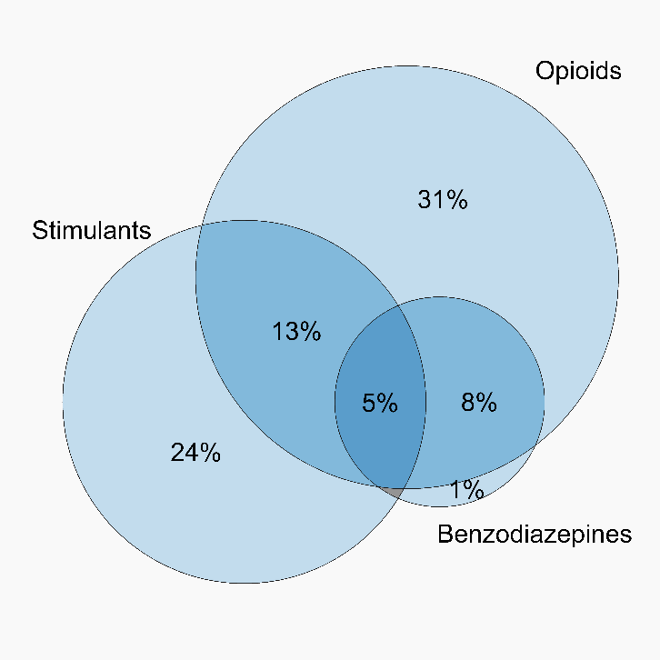
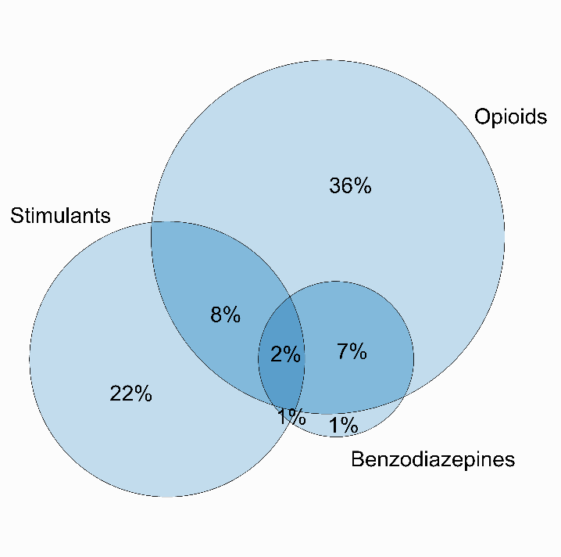
Figure 29: Use of opioids, stimulants and benzodiazepines on the day preceding interview, ACT, 2018-2019
2018
2019
Note. This figure captures those who had used stimulants, opioids and/or benzodiazepines on the day preceding interview (77%; n=77).
Notes:
Waiting for 2019 data

Slide 31
Figure 30: Past 12 month non-fatal overdose, ACT, 2000-2019
Note. Estimates from 2000-2005 refer to heroin and morphine non-fatal overdose only. *p<0.050; **p<0.010; ***p<0.001 for 2018 versus 2019.

Slide 32
Figure 31: Take-home naloxone program and distribution, ACT, 2013-2019
Note. *p<0.050; **p<0.010; ***p<0.001 for 2018 versus 2019.

Slide 33
Figure 32: Borrowing and lending of needles and sharing of injecting equipment in the past month, ACT, 2000-2019
Note. Data collection for ‘reused own needle’ started in 2008. Borrowed (receptive): used a needle after someone else. Lent (distributive): somebody else used a needle after them. Data labels have been removed from figures in years 2000, 2017 and 2018 with small cell size (i.e. n≤5). *p<0.050; **p<0.010; ***p<0.001 for 2018 versus 2019.

Slide 34
Figure 33: Injection-related issues in the past month, ACT, 2019
Note. Values suppressed due to small cell size (n≤5 but not 0). Y axis reduced to 60% to improve visibility of trends.
Notes:
Waiting for 2019 data

Slide 35
Figure 34: Driving risk behaviour in the last six months, ACT, 2005-2019
Note. Driven over the perceived limit of alcohol and driven a vehicle within three hours of using an illicit or non-prescribed drug. Data not collected in 2014. Data labels have been removed from figures in years 2005, 2017 and 2018 with small cell size (i.e. n≤5). *p<0.050; **p<0.010; ***p<0.001 for 2018 versus 2019
Notes:
Waiting for 2019 data

Slide 36
Figure 35: Self-reported mental health problems and treatment seeking in the past six months, ACT, 2004-2019
Note. Stacked bar graph of % who self-reported a mental health problem, disaggregated by the percentage who reported attending a health professional versus the percentage who have not. Data labels have been removed from figures throughout all years with small cell size (i.e. n≤5). *p<0.050; **p<0.010; ***p<0.001 for 2018 versus 2019.
Notes:
Had trouble finding 2019 figures

Slide 37
Figure 36: Self-reported criminal activity in the past month, ACT, 2000-2019
Note. ‘Any crime’ comprises the percentage who report any property crime, drug dealing, fraud and/or violent crime in the past month. Data labels have been removed from figures in years 2000, 2017 and 2018 with small cell size (i.e. n≤5). *p<0.050; **p<0.010; ***p<0.001 for 2018 versus 2019.

