Slide 1






Findings from the Australian Capital Territory 2019 Ecstasy and related Drugs Reporting System

Slide 2
Figure 1: Drug of choice, ACT, 2003-2019
Note. Substances listed in this figure are the primary endorsed; nominal percentages have endorsed other substances. Data labels have been removed from figures in years 2003, 2018 and 2019 with small cell size (i.e. n≤5). *p<0.050; **p<0.010; ***p<0.001 for 2018 versus 2019.

Slide 3
Figure 2: Drug used most often in the past month, ACT, 2011-2019
Note. Substances listed in this figure are the primary endorsed; nominal percentages have endorsed other substances. Data are only presented for 2011-2018 as this question was not asked in 2003-2010. Data labels have been removed from figures in years 2011, 2018 and 2019 with small cell size (i.e. n≤5). *p<0.050; **p<0.010; ***p<0.001 for 2018 versus 2019.

Slide 4
Figure 3: Weekly or more frequent substance use in the past six months, ACT, 2003-2019
Note. Among the entire sample. Data labels have been removed from figures in years 2003, 2018 and 2019 with small cell size (i.e. n≤5). *p<0.050; **p<0.010; ***p<0.001 for 2018 versus 2019.

Slide 5
Figure 4: Past six month use of any ecstasy, and ecstasy pills, powder, capsules, and crystal, ACT, 2003-2019
Note. Up until 2012, participant eligibility was determined based on any recent ecstasy use; subsequently it has been expanded to broader illicit stimulant use. Data collection for powder started in 2005, capsules in 2008 and crystal in 2013. *p<0.050; **p<0.010; ***p<0.001 for 2018 versus 2019.

Slide 6
Figure 5: Median days of any ecstasy and ecstasy pills, powder, capsules, and crystal use in the past six months, ACT, 2003-2019
Note. Up until 2012, participant eligibility was determined based on any recent ecstasy use; subsequently it has been expanded to broader illicit stimulant use. Data collection for powder started in 2005, capsules in 2008 and crystal in 2013. Median days computed among those who reported recent use (maximum 180 days). Median days rounded to the nearest whole number. Y axis reduced to 20 to improve visibility of trends. Data labels have been removed from figures in years 2003, 2018 and 2019 with small cell size (i.e. n≤5). *p<0.050; **p<0.010; ***p<0.001 for 2018 versus 2019.

Slide 7
Figure 6: Median price of ecstasy pill and capsule, ACT, 2003-2019
Note. Among those who commented. Data collection for price of ecstasy capsules started in 2008. *p<0.050; **p<0.010; ***p<0.001 for 2018 versus 2019.

Slide 8
Figure 7: Median price of ecstasy crystal per point and gram, ACT, 2013-2019
Note. Among those who commented. Data collection for price of ecstasy crystal gram and point started in 2013 and 2014 respectively. *p<0.050; **p<0.010; ***p<0.001 for 2018 versus 2019.

Slide 9
Figure 8: Median price of ecstasy powder per point and gram, ACT, 2013-2019
Note. Among those who commented. Data collection for price of ecstasy powder gram and point started in 2013. Data labels have been removed from figures with small cell size (i.e. n≤5). *p<0.050; **p<0.010; ***p<0.001 for 2018 versus 2019.

Slide 10
Figure 9: Past six month use of any methamphetamine, powder, base, and crystal, ACT, 2003-2019
Note. Data labels have been removed from figures in years 2003, 2017 and 2018 with small cell size (i.e. n≤5). *p<0.050; **p<0.010; ***p<0.001 for 2018 versus 2019.

Slide 11
Figure 10: Median days of any methamphetamine, powder, base, and crystal use in the past six months, ACT, 2003-2019
Note. Median days computed among those who reported recent use (maximum 180 days). Median days rounded to the nearest whole number. Y axis reduced to 12 to improve visibility of trends. Data labels have been removed from figures in years 2003, 2018 and 2019 with small cell size (i.e. n≤5). *p<0.050; **p<0.010; ***p<0.001 for 2018 versus 2019.

Slide 12
Figure 11: Median price of powder methamphetamine per point and gram, ACT, 2003-2019
Note. Among those who commented. *p<0.050; **p<0.010; ***p<0.001 for 2018 versus 2019.

Slide 13
Figure 12: Current perceived purity of powder methamphetamine, ACT, 2003-2019
Note. The response ‘Don’t know’ was excluded from analysis. Data labels have been removed from figures throughout all years with small cell size (i.e. n≤5). *p<0.050; **p<0.010; ***p<0.001 for 2018 versus 2019.

Slide 14
Figure 13: Current perceived availability of powder methamphetamine, ACT, 2003-2019
Note. The response ‘Don’t know’ was excluded from analysis. Data labels have been removed from figures throughout all years with small cell size (i.e. n≤5). *p<0.050; **p<0.010; ***p<0.001 for 2018 versus 2019.

Slide 15
Figure 14: Past six month use and frequency of use of cocaine, ACT, 2003-2019
Note. Median days computed among those who reported recent use (maximum 180 days). Median days rounded to the nearest whole number. Y axis reduced to 10 day to improve visibility of trends. Data labels have been removed from figures in years 2003, 2018 and 2019 with small cell size (i.e. n≤5). *p<0.050; **p<0.010; ***p<0.001 for 2018 versus 2019.

Slide 16
Figure 15: Median price of cocaine per gram, ACT, 2003-2019
Note. Among those who commented. *p<0.050; **p<0.010; ***p<0.001 for 2018 versus 2019.

Slide 17
Figure 16: Current perceived purity of cocaine, ACT, 2003-2019
Note. The response ‘Don’t know’ was excluded from analysis. Data labels have been removed from figures throughout all yeas with small cell size (i.e. n≤5). *p<0.050; **p<0.010; ***p<0.001 for 2018 versus 2019.

Slide 18
Figure 17: Current perceived availability of cocaine, ACT, 2003-2019
Note. The response ‘Don’t know’ was excluded from analysis. Data labels have been removed from figures throughout all yeas with small cell size (i.e. n≤5). *p<0.050; **p<0.010; ***p<0.001 for 2018 versus 2019.

Slide 19
Figure 18: Past six month use and frequency of use of cannabis, ACT, 2003-2019
Note. Median days computed among those who reported recent use (maximum 180 days). Median days rounded to the nearest whole number. Y axis reduced to 140 days to improve visibility of trends. *p<0.050; **p<0.010; ***p<0.001 for 2018 versus 2019.

Slide 20
Figure 19: Median price of hydroponic (a) and bush (b) cannabis per ounce and gram, ACT, 2006-2019
(A) Hydroponic cannabis
(B) Bush cannabis
Note. From 2006 onwards hydroponic and bush cannabis data collected separately. *p<0.050; **p<0.010; ***p<0.001 for 2018 versus 2019.

Slide 21
Figure 20: Current potency of hydroponic (a) and bush (b) cannabis, ACT, 2006-2019
(A) Hydroponic cannabis
(B) Bush cannabis
Note. The response ‘Don’t know’ was excluded from analysis. From 2006 onwards hydroponic and bush cannabis data collected separately. Data labels have been removed from figures throughout all yeas with small cell size (i.e. n≤5). *p<0.050; **p<0.010; ***p<0.001 for 2018 versus 2019.

Slide 22
Figure 21: Current perceived availability of hydroponic (a) and bush (b) cannabis, ACT, 2006-2019
(A) Hydroponic cannabis
(B) Bush cannabis
Note. The response ‘Don’t know’ was excluded from analysis. From 2006 onwards hydroponic and bush cannabis data collected separately. Data labels have been removed from figures throughout all yeas with small cell size (i.e. n≤5). *p<0.050; **p<0.010; ***p<0.001 for 2018 versus 2019.

Slide 23
Figure 22: Past six month use and frequency of use of ketamine, ACT, 2003-2019
Note. Median days computed among those who reported recent use (maximum 180 days). Median days rounded to the nearest whole number. Y axis reduced to 7 to improve visibility of trends. Data labels have been removed from figures in years 2003, 2018 and 2019 with small cell size (i.e. n≤5). *p<0.050; **p<0.010; ***p<0.001 for 2018 versus 2019.

Slide 24
Figure 23: Past six month use and frequency of use of LSD, ACT, 2003-2019
Note. Median days computed among those who reported recent use (maximum 180 days). Median days rounded to the nearest whole number. Y axis reduced to 5 to improve visibility of trends. Data labels have been removed from figures in years 2003, 2018 and 2019 with small cell size (i.e. n≤5). *p<0.050; **p<0.010; ***p<0.001 for 2018 versus 2019.

Slide 25
Figure 24: Median price of LSD per tab, ACT, 2003-2019
Note. Among those who commented. *p<0.050; **p<0.010; ***p<0.001 for 2018 versus 2019.

Slide 26
Figure 25: Current perceived purity of LSD, ACT, 2003-2019
Note. The response ‘Don’t know’ was excluded from analysis. Data labels have been removed from figures throughout all years with small cell size (i.e. n≤5). *p<0.050; **p<0.010; ***p<0.001 for 2018 versus 2019.

Slide 27
Figure 26: Current perceived availability of LSD, ACT, 2003-2019
Note. The response ‘Don’t know’ was excluded from analysis. Data labels have been removed from figures throughout all years with small cell size (i.e. n≤5). *p<0.050; **p<0.010; ***p<0.001 for 2018 versus 2019.

Slide 28
Figure 27: Past six months use and frequency of use of Mushrooms, ACT, 2003-2019
Note. Median days computed among those who reported recent use (maximum 180 days). Median days rounded to the nearest whole number. Y axis reduced to 20 days to improve visibility of trends. Data labels have been removed from figures with small cell size (i.e. n≤5). *p<0.050; **p<0.010; ***p<0.001 for 2018 versus 2019.

Slide 29
Figure 28: Past six months use of new psychoactive substances, ACT, 2010-2019
Note. Y axis reduced to 60% to improve visibility of trends. Data labels have been removed from figures with small cell size (i.e. n≤5) and to improve visibility. *p<0.050; **p<0.010; ***p<0.001 for 2018 versus 2019.

Slide 30
Figure 29: Non-prescribed use of pharmaceutical medicines in the past six months, ACT, 2007-2019
Note. Non-prescribed use is reported for prescription medicines (i.e., benzodiazepines, antipsychotics, and pharmaceutical stimulants). In February 2018, the scheduling for codeine changed such that low-dose codeine formerly available over-the-counter (OTC) was required to be obtained via a prescription. Note that estimates of codeine OTC use refer to use for non-pain purposes. Y axis has been reduced to 50% to improve visibility of trends. Data labels have been removed from figures in years 2003, 2018 and 2019 with small cell size (i.e. n≤5). *p<0.050; **p<0.010; ***p<0.001 for 2018 versus 2019.

Slide 31
Figure 30: Other illicit drugs used in the past six months, ACT, 2003-2019
Note. Monitoring of capsules contents unknown commenced in 2013. Y axis has been reduced to 50% to improve visibility of trends. Data labels have been removed from figures in years 2003, 2018 and 2019 with small cell size (i.e. n≤5). *p<0.050; **p<0.010; ***p<0.001 for 2018 versus 2019.

Slide 32
Figure 31: Licit and other drugs used in the past six months, ACT, 2003-2019
Note. Monitoring of e-cigarettes commenced in 2014. Data labels have been removed from figures in years 2003, 2018 and 2019 with small cell size (i.e. n≤5). *p<0.050; **p<0.010; ***p<0.001 for 2018 versus 2019.

Slide 33
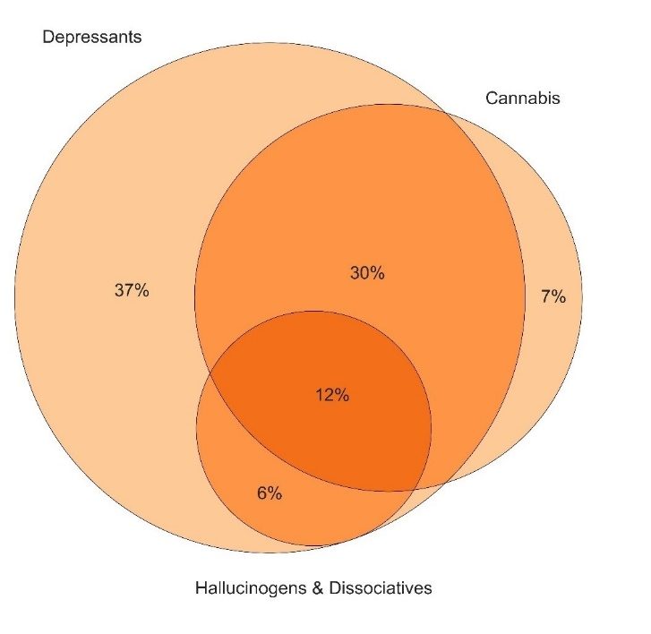
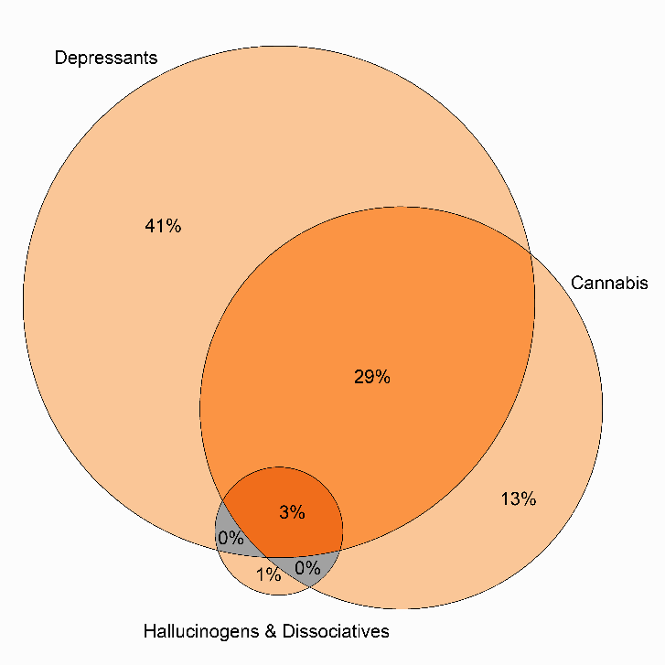
Figure 32: Poly substance use on occasion of last stimulant use among the total sample, ACT, 2018-2019
2018
2019
Note. This figure captures those who had also used hallucinogens/dissociatives (GHB, ketamine, LSD, and/or hallucinogenic mushrooms), depressants (alcohol and/or benzodiazepines) and/or cannabis on their last occasion of stimulant use.

Slide 34
Figure 33: Past year non-fatal stimulant and depressant overdose, ACT, 2007-2019
Note. Y axis has been reduced to 70% to improve visibility of trends. Data labels have been removed from figures in years 2007, 2018 and 2019 with small cell size (i.e. n≤5). *p<0.050; **p<0.010; ***p<0.001 for 2018 versus 2019.

Slide 35
Figure 34: Lifetime and past month drug injection, ACT, 2004-2019
Note. Data labels have been removed from figures in years 2004, 2018 and 2019 with small cell size (i.e. n≤5). *p<0.050; **p<0.010; ***p<0.001 for 2018 versus 2019.

Slide 36
Figure 35: Driving risk behaviour in the past six months, ACT, 2007-2019
Note. Data labels have been removed from figures with small cell size (i.e. n≤5 but not = 0). *p<0.050; **p<0.010; ***p<0.001 for 2018 versus 2019. Data not collected in 2014.
Notes:
2014 is missing from your report – so didn’t want to report numbers after in case they are reported in the wrong position

Slide 37
Figure 36: Self-reported mental health problems and treatment seeking in the past six months, ACT, 2008-2019
Note. The combination of the percentage who report treatment seeking and no treatment is the percentage who reported experiencing a mental health problem in the past six months. *p<0.050; **p<0.010; ***p<0.001 for 2018 versus 2019.

Slide 38
Figure 37: Self-reported criminal activity in the past month, ACT, 2003-2019
Note. Y axis has been reduced to 60% to improve visibility of trends. Data labels have been removed from figures in years 2003, 2018 and 2019 with small cell size (i.e. n≤5). *p<0.050; **p<0.010; ***p<0.001 for 2018 versus 2019.

