Slide 1






Key findings from the 2018 Northern Territory Ecstasy and related Drugs Reporting System

Slide 2
Figure 1: Number of participants recruited each year, NT, 2003-2008
Due to the small sample sizes recruited in 2010-2012, data from these years is not presented from hereon in; furthermore, data from 2006, 2008 and 2013 should be interpreted with caution.

Slide 3
Figure 2: Drug of choice, NT, 2003-2008
Note. Substances listed in this figure are the primary endorsed; nominal percentages have endorsed other substances. Data labels for 2017 and 2018 not presented where ≤5 people answered - interpret these data points with caution. *p<0.050; **p<0.010; ***p<0.001 for 2017 versus 2018.

Slide 4
Figure 3: Drug used most often in the past month, NT, 2013-2018
Note. Substances listed in this figure are the primary endorsed; nominal percentages have endorsed other substances. Data are only presented for 2011-2018 as this question was not asked in 2003-2010. Data labels for 2017 and 2018 not presented where ≤5 people answered - interpret these data points with caution. *p<0.050; **p<0.010; ***p<0.001 for 2017 versus 2018.

Slide 5
Figure 4: High frequency substance use in the past six months, NT, 2003-2018
Note. Among the entire sample. Days used any methamphetamine not captured in 2003, hence unable to calculate weekly or more use for this year. Data labels for 2017 and 2018 not presented where ≤5 people answered - interpret these data points with caution. *p<0.050; **p<0.010; ***p<0.001 for 2017 versus 2018.

Slide 6
Figure 5: Past six month use of the different forms of ecstasy (pills, powder, capsules, crystal and ‘any’), NT, 2003-2018
Note. Up until 2012, participant eligibility was determined based on any recent ecstasy use; subsequently it has been expanded to broader illicit stimulant use. Data collection for powder started in 2005, capsules in 2008 and crystal in 2013. *p<0.050; **p<0.010; ***p<0.001 for 2017 versus 2018.

Slide 7
Figure 6: Median days of any ecstasy, pills, powder, capsules, and crystal use in the past six months, NT, 2003-2018
Note. Up until 2012, participant eligibility was determined based on any recent ecstasy use; subsequently it has been expanded to broader illicit stimulant use. Data collection for powder started in 2005, capsules in 2008 and crystal in 2013. Median days computed among those who reported recent use (maximum 180 days). Median days rounded to the nearest whole number. Y axis reduced to 30 to improve visibility of trends. *p<0.050; **p<0.010; ***p<0.001 for 2017 versus 2018.

Slide 8
Figure 7: Median price of ecstasy pill, NT, 2003-2018
Note. Among those who commented. *p<0.050; **p<0.010; ***p<0.001 for 2017 versus 2018.

Slide 9
Figure 8: Median price of ecstasy capsule, NT, 2008-2018
Note. Among those who commented. Data collection for price of ecstasy capsules started in 2008. No participants reported on the price of capsules in 2013. *p<0.050; **p<0.010; ***p<0.001 for 2017 versus 2018.
.

Slide 10
Figure 9: Median price of ecstasy powder per point and gram, NT, 2014-2018
Note. Among those who commented. Data labels not presented where ≤5 people answered - interpret these data points with caution. In 2013, no participants reported on the price for ecstasy powder; in 2017 no participants reported on the price for a point of ecstasy powder; *p<0.050; **p<0.010; ***p<0.001 for 2017 versus 2018.

Slide 11
Figure 10: Median price of ecstasy crystal per point and gram, NT, 2014-2018
Note. Among those who commented. Data labels not presented where ≤5 people answered - interpret these data points with caution. Data collection for price of ecstasy crystal gram and point started in 2013 and 2014 respectively. In 2013, no participants reported on the price for crystal. *p<0.050; **p<0.010; ***p<0.001 for 2017 versus 2018.

Slide 12
Figure 11: Past six month use of any methamphetamine, powder and crystal, NT, 2003-2018
Note. Figures for base methamphetamine not presented due to small numbers reporting use. In 2008, no participants reported use of crystal methamphetamine. *p<0.050; **p<0.010; ***p<0.001 for 2017 versus 2018.

Slide 13
Figure 12: Median days of any methamphetamine, powder, and crystal use in the past six months, NT, 2003-2018
Note. Median days computed among those who reported recent use (maximum 180 days). Median days rounded to the nearest whole number. Y axis reduced to 30 to improve visibility of trends. Figures for base methamphetamine not presented due to small numbers reporting use. In 2008, no participants reported use of crystal methamphetamine. *p<0.050; **p<0.010; ***p<0.001 for 2017 versus 2018.

Slide 14
Figure 13: Median price of powder methamphetamine per point and gram, NT, 2003-2018
Note. Among those who commented. Data labels not presented where ≤5 people answered - interpret these data points with caution. In 2008 and 2013, no participants commented on the price for a point of powder methamphetamine. *p<0.050; **p<0.010; ***p<0.001 for 2017 versus 2018.

Slide 15
Figure 14: Current perceived purity of powder methamphetamine, NT, 2003-2018
Note. The response ‘Don’t know’ was excluded from analysis. *p<0.050; **p<0.010; ***p<0.001 for 2017 versus 2018.

Slide 16
Figure 15: Current perceived availability of powder methamphetamine, NT, 2003-2018
Note. The response ‘Don’t know’ was excluded from analysis. *p<0.050; **p<0.010; ***p<0.001 for 2017 versus 2018.

Slide 17
Figure 16: Median price of crystal methamphetamine per point and gram, NT, 2003-2018
Note. Among those who commented. Data labels not presented where ≤5 people answered - interpret these data points with caution. In 2008, no participants commented on the price for a point or gram of crystal methamphetamine. *p<0.050; **p<0.010; ***p<0.001 for 2017 versus 2018.

Slide 18
Figure 17: Current perceived purity of crystal methamphetamine, NT, 2003-2018
Note. The response ‘Don’t know’ was excluded from analysis. In 2008, no participants answered this question. Data labels not presented where ≤5 people answered (2009) - interpret these data points with caution. *p<0.050; **p<0.010; ***p<0.001 for 2017 versus 2018.

Slide 19
Figure 18: Current perceived availability of crystal methamphetamine, NT, 2003-2018
Note. The response ‘Don’t know’ was excluded from analysis. In 2008, no participants answered this question. Data labels not presented where ≤5 people answered (2006, 2009) - interpret these data points with caution. *p<0.050; **p<0.010; ***p<0.001 for 2017 versus 2018.
.

Slide 20
Figure 19: Past six month use and frequency of use of cocaine, NT, 2003-2018
Note. Data labels not presented where ≤5 people answered (2006, 2009) - interpret these data points with caution. Median days computed among those who reported recent use (maximum 180 days). Median days rounded to the nearest whole number. *p<0.050; **p<0.010; ***p<0.001 for 2017 versus 2018.

Slide 21
Figure 20: Median price of cocaine per gram, NT, 2013-2018
Note. Among those who commented. Prices not reported prior to 2013 due to small numbers commenting. *p<0.050; **p<0.010; ***p<0.001 for 2017 versus 2018.

Slide 22
Figure 21: Current perceived purity of cocaine, NT, 2003-2018
Note. The response ‘Don’t know’ was excluded from analysis. Data labels not presented where ≤5 people answered (2003, 2006- 2009) - interpret these data points with caution. *p<0.050; **p<0.010; ***p<0.001 for 2017 versus 2018.
.

Slide 23
Figure 22: Current perceived availability of cocaine, NT, 2003-2018
Note. The response ‘Don’t know’ was excluded from analysis. Data labels not presented where ≤5 people answered (2004, 2006- 2009) - interpret these data points with caution. **p<0.010; ***p<0.001 for 2017 versus 2018.

Slide 24
Figure 23: Past six month use and frequency of use of cannabis, NT, 2003-2018
Note. Median days computed among those who reported recent use (maximum 180 days). Median days rounded to the nearest whole number.. *p<0.050; **p<0.010; ***p<0.001 for 2017 versus 2018.

Slide 25
Figure 24: Median price of hydroponic (a) and bush (b) cannabis per ounce and gram, NT, 2006-2018
(A) Hydroponic cannabis
(B) Bush cannabis
Note. From 2006 onwards hydroponic and bush cannabis data collected separately. Data labels not presented where ≤5 people answered - interpret these data points with caution. *p<0.050; **p<0.010; ***p<0.001 for 2017 versus 2018.

Slide 26
Figure 25: Current potency of hydroponic (a) and bush (b) cannabis, NT, 2006-2018
(A) Hydroponic cannabis
(B) Bush cannabis
Note. The response ‘Don’t know’ was excluded from analysis. From 2006 onwards hydroponic and bush cannabis data collected separately. *p<0.050; **p<0.010; ***p<0.001 for 2017 versus 2018.

Slide 27
Figure 26: Current perceived availability of hydroponic (a) and bush (b) cannabis, NT, 2006-2018
(A) Hydroponic cannabis
(B) Bush cannabis
Note. The response ‘Don’t know’ was excluded from analysis. From 2006 onwards hydroponic and bush cannabis data collected separately. *p<0.050; **p<0.010; ***p<0.001 for 2017 versus 2018.

Slide 28
Figure 27: Past six month use and frequency of use of ketamine, NT, 2003-2018
Note. Median days computed among those who reported recent use (maximum 180 days). Median days rounded to the nearest whole number. Data labels not presented where ≤5 people answered - interpret these data points with caution. *p<0.050; **p<0.010; ***p<0.001 for 2017 versus 2018.

Slide 29
Figure 28: Past six month use and frequency of use of LSD, NT, 2003-2018
Note. Median days computed among those who reported recent use (maximum 180 days). Median days rounded to the nearest whole number. *p<0.050; **p<0.010; ***p<0.001 for 2017 versus 2018.

Slide 30
Figure 29: Median price of LSD per tab, NT, 2003-2018
Note. Among those who commented. Data labels not presented where ≤5 people answered (2009) - interpret these data points with caution. *p<0.050; **p<0.010; ***p<0.001 for 2017 versus 2018.

Slide 31
Figure 30: Current perceived purity of LSD, NT, 2003-2018
Note. The response ‘Don’t know’ was excluded from analysis. Data labels not presented where ≤5 people answered (2008, 2009) - interpret these data points with caution. *p<0.050; **p<0.010; ***p<0.001 for 2017 versus 2018.

Slide 32
Figure 31: Current perceived availability of LSD, NT, 2003-2018
Note. The response ‘Don’t know’ was excluded from analysis. Data labels not presented where ≤5 people answered (2008, 2009) - interpret these data points with caution. *p<0.050; **p<0.010; ***p<0.001 for 2017 versus 2018.

Slide 33
Figure 32: Past six month use of ‘any’ NPS, synthetic cannabinoids, DMT, 2C-B and herbal highs in the past six months, NT, 2013-2018
Note. Axis reduced to 50% to improve visibility of trends. Use of all NPS not reported due to low number reporting use (n≤5). Data labels for 2003, 2017 and 2018 not presented where n≤5. Use of synthetic cannabinoids were first asked about in 2011 and herbals highs in 2012. *p<0.050; **p<0.010; ***p<0.001 for 2017 versus 2018.

Slide 34
Figure 33: Non-prescribed use of pharmaceutical drugs in the past six months, NT, 2007-2018
Note. Non-prescribed use is reported for prescription medicines (i.e., benzodiazepines, antipsychotics, and pharmaceutical stimulants). In February 2018, the scheduling for codeine changed such that low-dose codeine formerly available over-the-counter (OTC) was required to be obtained via a prescription. Note that estimates of codeine OTC use refer to use for non-pain purposes. Data labels for 2017 and 2018 not presented where n≤5. Y axis has been reduced to 30% to improve visibility of trends. *p<0.050; **p<0.010; ***p<0.001 for 2017 versus 2018.

Slide 35
Figure 34: Other illicit drugs used in the past six months, NT, 2003-2018
Note. Monitoring of capsules contents unknown commenced in 2013. Data labels for 2003, 2017 and 2018 not presented where n≤5. Y axis has been reduced to 30% to improve visibility of trends. *p<0.050; **p<0.010; ***p<0.001 for 2017 versus 2018.

Slide 36
Figure 35: Licit drugs used in the past six months, NT, 2003-2018
Note. Monitoring of e-cigarettes commenced in 2014. Data labels for 2003, 2017 and 2018 not presented where n≤5. *p<0.050; **p<0.010; ***p<0.001 for 2017 versus 2018.

Slide 37
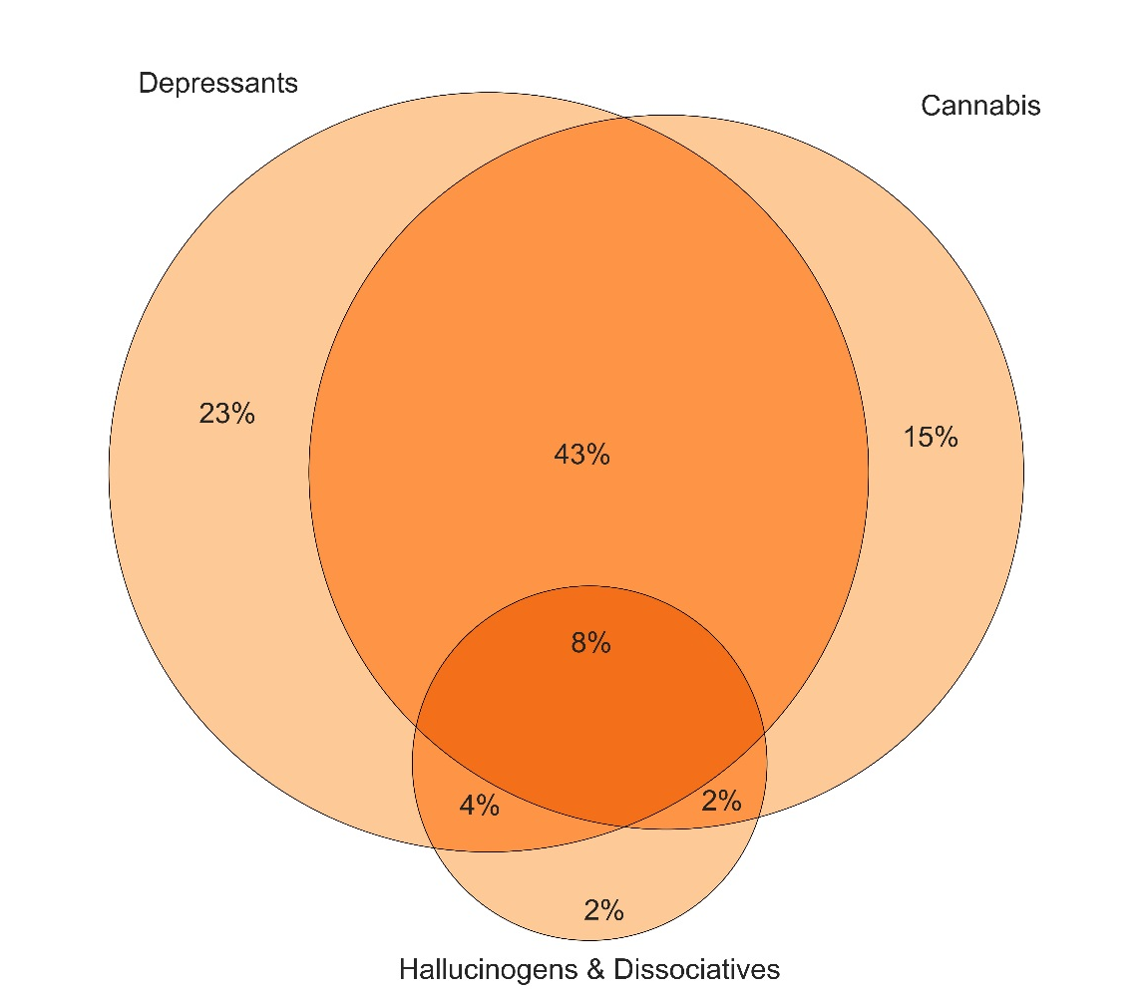
Figure 36: Poly substance use on occasion of last stimulant use, NT, 2018
Note. This figure captures those who had simultaneously used hallucinogens/dissociatives (GHB, ketamine, LSD, and/or hallucinogenic mushrooms), depressants (alcohol and/or benzodiazepines) and/or cannabis on their last occasion of stimulant use (98% of the sample). Not to scale.

Slide 38
Figure 37: Lifetime and past year non-fatal stimulant overdose, NT, 2007-2018
Note. Data labels not presented where n≤5. *p<0.050; **p<0.010; ***p<0.001 for 2017 versus 2018.

Slide 39
Figure 38: Lifetime and past year non-fatal depressant overdose, NT, 2007-2018
Note. Data labels not presented where n≤5. *p<0.050; **p<0.010; ***p<0.001 for 2017 versus 2018.

Slide 40
Figure 39: Lifetime and past month drug injection, NT, 2004-2018
Note. Past six-month injection asked of participants prior to 2016. Data labels not presented where n≤5. *p<0.050; **p<0.010; ***p<0.001 for 2017 versus 2018.

Slide 41
Figure 40: Current drug treatment, NT, 2003-2018
Note. Data labels not presented where n≤5. *p<0.050; **p<0.010; ***p<0.001 for 2017 versus 2018.

Slide 42
Figure 41: Sex with a casual partner in the last six months and use of any protection/barrier on the last occasion, NT, 2013-2018
Note. The combination of the percentage who report protection used, no protection used and unknown if protection used is the percentage who reported penetrative sex with a causal partner in the past six months. Data labels not presented where n≤5. *p<0.050; **p<0.010; ***p<0.001 for 2017 versus 2018.

Slide 43
Figure 42: Self-reported mental health problems and treatment seeking in the past six months, NT, 2008-2018
Note. The combination of the percentage who reported seeking treatment, not seeking treatment and unknown if treatment sought is the percentage who reported experiencing a mental health problem in the past six months. Data labels not presented where n≤5. *p<0.050; **p<0.010; ***p<0.001 for 2017 versus 2018.

Slide 44
Figure 43: Self-reported criminal activity in the past month, NT, 2003-2018
Note. Y axis has been reduced to 50% to improve visibility of trends. Data labels for 2003, 2017 and 2018 not presented where n≤5. *p<0.050; **p<0.010; ***p<0.001 for 2017 versus 2018.

