Slide 1






Key findings from the 2018 NSW Ecstasy and related Drugs Reporting System

Slide 2
Figure 1: Drug of choice, NSW, 2003-2008
Note. Substances listed in this figure are the primary endorsed; nominal percentages have endorsed other substances. Data labels have been removed from figures in years 2003, 2017 and 2018 with small cell size (i.e. n≤5). p<0.050; **p<0.010; ***p<0.001 for 2017 versus 2018.

Slide 3
Figure 2: Drug used most often in the past month, NSW, 2011-2018
Note. Substances listed in this figure are the primary endorsed; nominal percentages have endorsed other substances. Data labels have been removed from figures in years 2011, 2017 and 2018 with small cell size (i.e. n≤5). Data are only presented for 2011-2018 as this question was not asked in 2003-2010. *p<0.050; **p<0.010; ***p<0.001 for 2017 versus 2018.

Slide 4
Figure 3: High frequency substance use in the past six months, NSW, 2003-2018
Note. Among the entire sample. Data labels have been removed from figures with small cell size (i.e. n≤5 but not =0). *p<0.050; **p<0.010; ***p<0.001 for 2017 versus 2018.

Slide 5
Figure 4: Past six month use of any ecstasy, and ecstasy pills, powder, capsules, and crystal, NSW, 2003-2018
Note. Up until 2012, participant eligibility was determined based on any recent ecstasy use; subsequently it has been expanded to broader illicit stimulant use. Data collection for powder started in 2005, capsules in 2008 and crystal in 2013 Data labels have been removed from figures in years 2017 and 2018 with small cell size (i.e. n≤5). *p<0.050; **p<0.010; ***p<0.001 for 2017 versus 2018.

Slide 6
Figure 5: Median days of any ecstasy, pills, powder, capsules, and crystal use in the past six months, NSW, 2003-2018
Note. Up until 2012, participant eligibility was determined based on any recent ecstasy use; subsequently it has been expanded to broader illicit stimulant use. Data collection for powder started in 2005, capsules in 2008 and crystal in 2013. Median days computed among those who reported recent use (maximum 180 days). Median days rounded to the nearest whole number. Y axis reduced to 30 to improve visibility of trends. Data labels have been removed from figures with small cell size (i.e. n≤5). *p<0.050; **p<0.010; ***p<0.001 for 2017 versus 2018.

Slide 7
Figure 6: Median price of ecstasy pill and capsule, NSW, 2003-2017
Note. Among those who commented. Data collection for price of ecstasy capsules started in 2008. Data labels have been removed from figures in years 2017 and 2018 with small cell size (i.e. n≤5). *p<0.050; **p<0.010; ***p<0.001 for 2017 versus 2018.

Slide 8
Figure 7: Median price of ecstasy crystal and powder per point and gram, NSW, 2013-2018
Note. Among those who commented. Data collection for price of ecstasy crystal gram and point started in 2013 and 2014 respectively. Data labels have been removed from figures in years 2017 and 2018 with small cell size (i.e. n≤5). *p<0.050; **p<0.010; ***p<0.001 for 2017 versus 2018.

Slide 9
Figure 8: Past six month use of any methamphetamine, powder, base, and crystal, NSW, 2003-2018
Note. Data labels have been removed from figures in years 2017 and 2018 with small cell size (i.e. n≤5). *p<0.050; **p<0.010; ***p<0.001 for 2017 versus 2018.

Slide 10
Figure 9: Median days of any methamphetamine, powder, base, and crystal use in the past six months, NSW, 2003-2018
Note. Median days computed among those who reported recent use (maximum 180 days). Median days rounded to the nearest whole number. Y axis reduced to 14 to improve visibility of trends. Data labels have been removed from figures in years 2017 and 2018 with small cell size (i.e. n≤5). *p<0.050; **p<0.010; ***p<0.001 for 2017 versus 2018.

Slide 11
Figure 10: Median price of powder methamphetamine per point and gram, NSW, 2003-2018
Note. Among those who commented. Data labels have been removed from figures in years 2003, 2017 and 2018 with small cell size (i.e. n≤5). *p<0.050; **p<0.010; ***p<0.001 for 2017 versus 2018.

Slide 12
Figure 11: Current perceived purity of powder methamphetamine, NSW, 2003-2018
Note. The response ‘Don’t know’ was excluded from analysis. Data labels have been removed from figures with small cell size (i.e. n≤5). *p<0.050; **p<0.010; ***p<0.001 for 2017 versus 2018.

Slide 13
Figure 12: Current perceived availability of powder methamphetamine, NSW, 2003-2018
Note. The response ‘Don’t know’ was excluded from analysis. Data labels have been removed from figures with small cell size (i.e. n≤5). *p<0.050; **p<0.010; ***p<0.001 for 2017 versus 2018.

Slide 14
Figure 13: Past six month use and frequency of use of cocaine, NSW, 2003-2018
Note. Median days computed among those who reported recent use (maximum 180 days). Median days rounded to the nearest whole number. Y axis reduced to 6 to improve visibility of trends for days of use. Data labels have been removed from figures in years 2017 and 2018 with small cell size (i.e. n≤5). *p<0.050; **p<0.010; ***p<0.001 for 2017 versus 2018.

Slide 15
Figure 14: Median price of cocaine per gram, NSW, 2003-2018
Note. Among those who commented. Data labels have been removed from figures in years 2017 and 2018 with small cell size (i.e. n≤5). *p<0.050; **p<0.010; ***p<0.001 for 2017 versus 2018.

Slide 16
Figure 15: Current perceived purity of cocaine, NSW, 2003-2018
Note. The response ‘Don’t know’ was excluded from analysis. Data labels have been removed from figures with small cell size (i.e. n≤5). *p<0.050; **p<0.010; ***p<0.001 for 2017 versus 2018.

Slide 17
Figure 16: Current perceived availability of cocaine, NSW, 2003-2018
Note. The response ‘Don’t know’ was excluded from analysis. Data labels have been removed from figures with small cell size (i.e. n≤5). *p<0.050; **p<0.010; ***p<0.001 for 2017 versus 2018.

Slide 18
Figure 17: Past six month use and frequency of use of cannabis, NSW, 2003-2018
Note. Median days computed among those who reported recent use (maximum 180 days). Median days rounded to the nearest whole number. Y axis reduced to 90 to improve visibility of trends in days of use. Data labels have been removed from figures in years 2003, 2017 and 2018 with small cell size (i.e. n≤5). *p<0.050; **p<0.010; ***p<0.001 for 2017 versus 2018.

Slide 19
Figure 18: Median price of hydroponic (a) and bush (b) cannabis per ounce and gram, NSW, 2006-2018
(A) Hydroponic cannabis
(B) Bush cannabis
Note. From 2006 onwards hydroponic and bush cannabis data collected separately. Data labels have been removed from figures in years 2017 and 2018 with small cell size (i.e. n≤5 but not =0). *p<0.050; **p<0.010; ***p<0.001 for 2017 versus 2018.

Slide 20
Figure 19: Current potency of hydroponic (a) and bush (b) cannabis, NSW, 2006-2018
(A) Hydroponic cannabis
(B) Bush cannabis
Note. The response ‘Don’t know’ was excluded from analysis. From 2006 onwards hydroponic and bush cannabis data collected separately. Data labels have been removed from figures with small cell size (i.e. n≤5). *p<0.050; **p<0.010; ***p<0.001 for 2017 versus 2018.

Slide 21
Figure 20: Current perceived availability of hydroponic (a) and bush (b) cannabis, NSW, 2006-2018
(A) Hydroponic cannabis
(B) Bush cannabis
Note. The response ‘Don’t know’ was excluded from analysis. From 2006 onwards hydroponic and bush cannabis data collected separately. Data labels have been removed from figures with small cell size (i.e. n≤5). *p<0.050; **p<0.010; ***p<0.001 for 2017 versus 2018.

Slide 22
Figure 21: Past six month use and frequency of use of ketamine, NSW, 2003-2018
Note. Median days computed among those who reported recent use (maximum 180 days). Median days rounded to the nearest whole number. Y axis reduced to 5 days to improve visibility of trends. Data labels have been removed from figures in years 2017 and 2018 with small cell size (i.e. n≤5). *p<0.050; **p<0.010; ***p<0.001 for 2017 versus 2018.

Slide 23
Figure 22: Past six month use and frequency of use of LSD, NSW, 2003-2018
Note. Median days computed among those who reported recent use (maximum 180 days). Median days rounded to the nearest whole number. Y axis reduced to 5 days to improve visibility of trends. Data labels have been removed from figures in years 2017 and 2018 with small cell size (i.e. n≤5). *p<0.050; **p<0.010; ***p<0.001 for 2017 versus 2018.

Slide 24
Figure 23: Median price of ketamine per gram, NSW, 2003-2018
Note. Among those who commented. Data labels have been removed from figures in years 2017 and 2018 with small cell size (i.e. n≤5). *p<0.050; **p<0.010; ***p<0.001 for 2017 versus 2018.

Slide 25
Figure 24: Current perceived purity of ketamine, NSW, 2003-2018
Note. The response ‘Don’t know’ was excluded from analysis. Data labels have been removed from figures with small cell size (i.e. n≤5). *p<0.050; **p<0.010; ***p<0.001 for 2017 versus 2018.

Slide 26
Figure 25: Current perceived availability of ketamine, NSW, 2003-2018
Note. The response ‘Don’t know’ was excluded from analysis. Data labels have been removed from figures with small cell size (i.e. n≤5). *p<0.050; **p<0.010; ***p<0.001 for 2017 versus 2018.

Slide 27
Figure 26: Median price of LSD per tab, NSW, 2003-2018
Note. Among those who commented. Data labels have been removed from figures in years 2017 and 2018 with small cell size (i.e. n≤5). *p<0.050; **p<0.010; ***p<0.001 for 2017 versus 2018.

Slide 28
Figure 27: Current perceived purity of LSD, NSW, 2003-2018
Note. The response ‘Don’t know’ was excluded from analysis. Data labels have been removed from figures with small cell size (i.e. n≤5). *p<0.050; **p<0.010; ***p<0.001 for 2017 versus 2018.

Slide 29
Figure 28: Current perceived availability of LSD, NSW, 2003-2018
Note. The response ‘Don’t know’ was excluded from analysis. Data labels have been removed from with small cell size (i.e. n≤5). *p<0.050; **p<0.010; ***p<0.001 for 2017 versus 2018.

Slide 30
Figure 29: Recent use of any NPS, NSW, 2010-2018
Note. Data labels have been removed from figures in years 2017 and 2018 with small cell size (i.e. n≤5). *p<0.050; **p<0.010; ***p<0.001 for 2017 versus 2018.

Slide 31
Figure 30: Recent use of NPS, NSW, 2010-2018
Note. Y axis reduced to 30% to improve visibility of trends. Data labels have been removed from figures with small cell size (i.e. n≤5). *p<0.050; **p<0.010; ***p<0.001 for 2017 versus 2018.

Slide 32
Figure 31: Non-prescribed use of pharmaceutical drugs in the past six months, NSW, 2007-2018
Note. Non-prescribed use is reported for prescription medicines (i.e., benzodiazepines, antipsychotics, and pharmaceutical stimulants). In February 2018, the scheduling for codeine changed such that low-dose codeine formerly available over-the-counter (OTC) was required to be obtained via a prescription. Note that estimates of codeine OTC use refer to use for non-pain purposes. Y axis reduced to 60% to improve visibility of trends. Data labels have been removed from figures in 2007, 2017 and 2018 with small cell size (i.e. n≤5 but not =0). *p<0.050; **p<0.010; ***p<0.001 for 2017 versus 2018

Slide 33
Figure 32: Other illicit drugs used in the past six months, NSW, 2003-2018
Note. Monitoring of capsules contents unknown commenced in 2013. Y axis has been reduced to 50% to improve visibility of trends. Data labels have been removed from figures in 2017 and 2018 with small cell size (i.e. n≤5). *p<0.050; **p<0.010; ***p<0.001 for 2017 versus 2018.

Slide 34
Figure 33: Licit drugs used in the past six months, NSW, 2003-2018
Note. Monitoring of e-cigarettes commenced in 2014. Data labels have been removed from figures in 2017 and 2018 with small cell size (i.e. n≤5). *p<0.050; **p<0.010; ***p<0.001 for 2017 versus 2018.

Slide 35
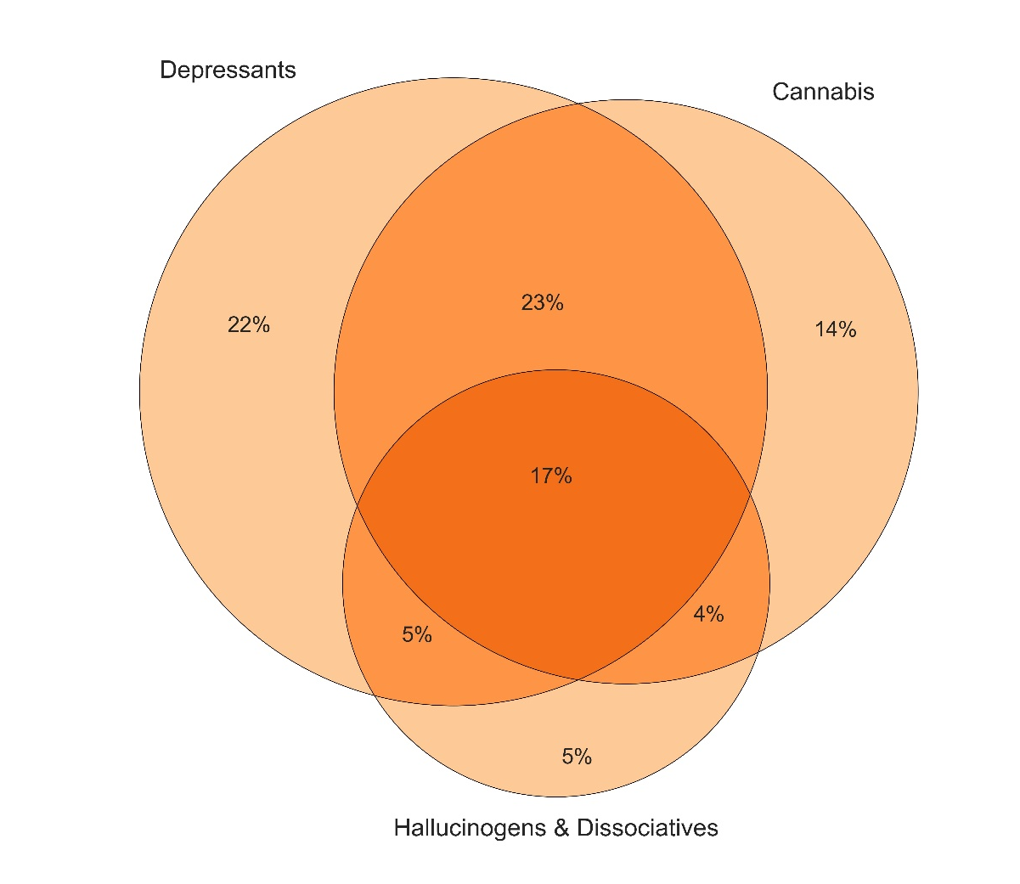
Figure 34: Poly substance use on occasion of last stimulant use, NSW, 2018
Note. This figure captures those who had also used hallucinogens/dissociatives (GHB, ketamine, LSD, and/or hallucinogenic mushrooms), depressants (alcohol and/or benzodiazepines) and/or cannabis on their last occasion of stimulant use.

Slide 36
Figure 35: Lifetime and past year non-fatal stimulant and depressant overdose, NSW, 2006-2018
Note. Y axis has been reduced to 50% to improve visibility of trends. Data labels have been removed from figures in years 2006, 2017 and 2018 with small cell size (i.e. n≤5). *p<0.050; **p<0.010; ***p<0.001 for 2017 versus 2018.

Slide 37
Figure 36: Lifetime and past month drug injection, NSW, 2004-2018
Note. Y axis reduced to 50% to improve visibility of trends. Past 6-month injection asked of participants prior to 2016. Data labels have been removed from figures in 2017 and 2018 with small cell size (i.e. n≤5). *p<0.050; **p<0.010; ***p<0.001 for 2017 versus 2018.

Slide 38
Figure 37: Sex with a casual partner in the last six months and use of any protection/barrier on the last occasion, NSW, 2011-2018
Note. Don’t know and did not respond responses excluded. The combination of the percentage who report protection used and no protection used is the percentage who reported penetrative sex with a casual partner in the past six months. Data labels have been removed from figures with small cell size (i.e. n≤5). *p<0.050; **p<0.010; ***p<0.001 for 2017 versus 2018.

Slide 39
Figure 38: Self-reported mental health problems and treatment seeking in the past six months, NSW, 2008-2018
Note. The combination of the percentage who report treatment seeking and no treatment is the percentage who reported experiencing a mental health problem in the past six months. Data labels have been removed from figures with small cell size (i.e. n≤5). *p<0.050; **p<0.010; ***p<0.001 for 2017 versus 2018.

Slide 40
Figure 49: Self-reported criminal activity in the past month, NSW, 2003-2018
Note. ‘Any crime’ comprises the percentage who report any property crime, drug dealing, fraud and/or violent crime in the past month. Y axis has been reduced to 50% to improve visibility of trends. Data labels have been removed from figures in 2003, 2017 and 2018 with small cell size (i.e. n≤5). *p<0.050; **p<0.010; ***p<0.001 for 2017 versus 2018.

